Slide 1
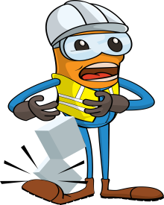
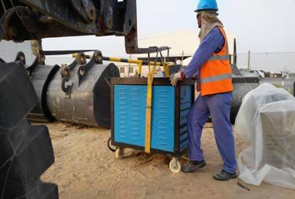
PDO Incident First Alert
Incident type | LTI (#22) | PIM ID | 1094237
Date/ time | 01/08/2016 (18:00 hrs) | Directorate
Location | Galfar Fabrication yard/ Fahud | Dept
What happened
Whilst off loading a Post Weld Heat Treatment machine from a pickup with a forklift. The rigger used a single sling belt to lift up the machine and offload it on to uneven ground. He attempted to adjust it on the ground however the machine swung to its right landing on his foot resulting in a fractured right foot.
Mr. Musleh asks the questions of can it happen to you?
Do you always use the correct lifting procedure?
Do you ensure you have the right tools for the job?
Do you consider if you are ever in the ‘line of fire’?
Please disseminate this LTI notification to your teams and use it in your tool box talks and HSE meetings and notice boards.

