Slide 1
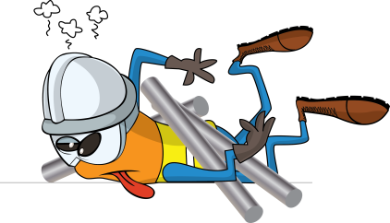
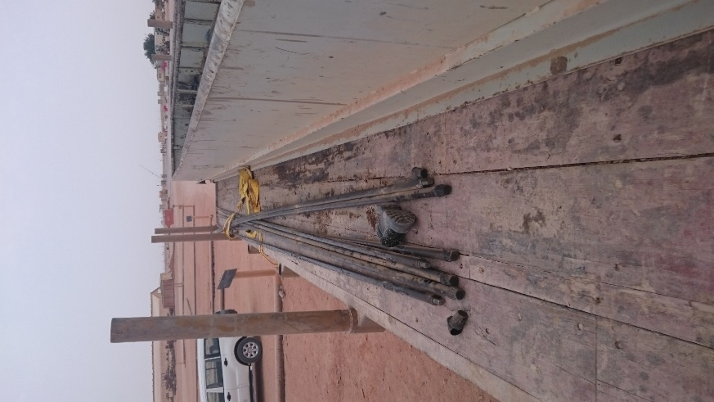


PDO Incident First Alert
Incident type | LTI (#21a) | PIM ID | 1094297
Date/ time | 07/08/2016 (16:50 hrs) | Directorate
Location | Nimr Logistics Yard | Dept
What happened
Sucker rods were being loaded into a skid bin mounted on the back of a trailer by a forklift. As the forklift operator drove forward and prepared to lower a loose bundle of rods resting on his forks into the skid the vehicle helper jumped up on to the trailer on the opposite side of the forklift. The forklift operator was startled and reacted by doing an emergency stop which caused the rods to roll forward off the forks, strike the far edge of the skid bin and over the top before falling onto the helper’s legs resulting in multiple fractures to his legs.
Mr. Musleh asks the questions of can it happen to you?
Do you always ensure the area is clear whilst loading?
Do you always stop lifting operations when people come into the lifting zone?
Do you always consider if you are in the ‘line of fire’?
Helper position when hit by rods
Please disseminate this LTI notification to your teams and use it in your tool box talks and HSE meetings and notice boards.

