Slide 1
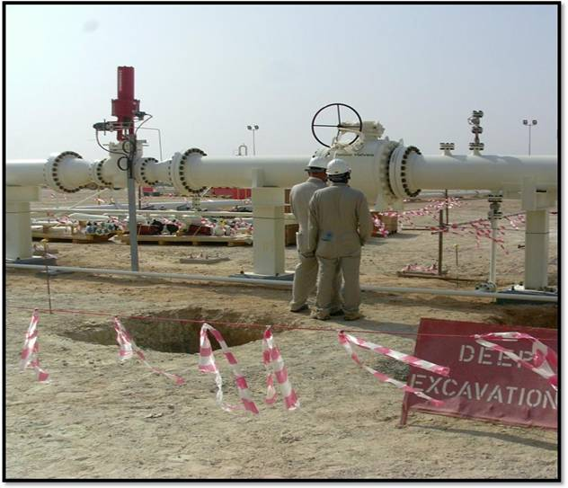
PDO Incident First Alert
Incident type | LTI (#22a) | PIM ID | 1094452
Date/ time | 17/08/2016 (09:20 hrs) | Directorate
Location | Musallam Station, Qarn Alam | Dept
What happened
A Piping Engineer was surveying the pipe layout with a colleague. He stepped backwards whilst studying the position of the pipes but failed to notice a half meter deep pit behind him. He fell into the pit twisting his left ankle resulting in a fracture to his left ankle.
Mr. Musleh asks the questions of can it happen to you?
Do you leave excavated pits barricaded to prevent others accessing?
Do you always check your surroundings for hazards?
Do you watch out for and observe warning signs?
Piping Engineer stepped back & slipped into the 54 cm deep pit, twisting his left ankle
Please disseminate this LTI notification to your teams and use it in your tool box talks and HSE meetings and notice boards.

