Slide 1
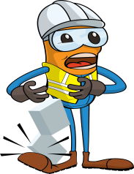
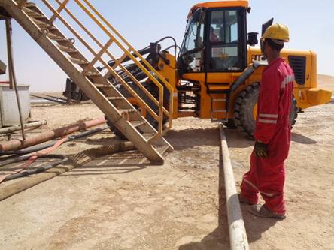
PDO Incident First Alert
Incident type | LTI (#23) | PIM ID | 1094469
Date/ time | 19.08.2016 at 05:30 Hrs. | Directorate
Location | Rig 99 Lekhwair | Dept
What happened
A rig crew were repositioning an Oil-Based-Mud cutting tank and the roustabout was asked to fetch a webbing sling. He paused as he approached the flare line to keep out of the way of a forklift which was reversing nearby. As he waited he mistakenly placed his right foot under the flare line which pressed down as the forklift drove over it. His right foot was trapped against the ground resulting in a fracture to his ankle.
Mr. Musleh asks the questions of can it happen to you?
Do you ensure you are stood in a safe place?
Do you stop operations when people enter restricted work areas?
Do you always consider if you are in the ‘line of fire’?
Please disseminate this LTI notification to your teams and use it in your tool box talks and HSE meetings and notice boards.

