Slide 1
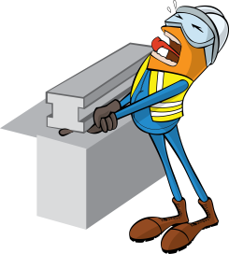
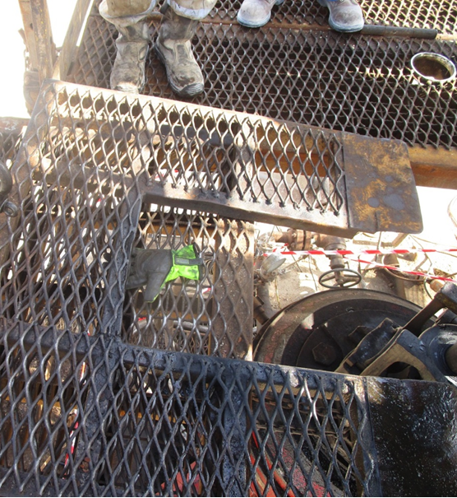


PDO Incident First Alert
Incident type | LTI (#24) | PIM ID | 1094514
Date/ time | 24.08.2016 at 09:40 hrs. | Directorate
Location | Hoist 18 Sayallah | Dept
What happened
After installing the false rotary table the Electrical Submerged Pump (ESP) engineer adjusted the floor cover on the rig floor. As he did so the cover fell trapping the middle finger on his left hand between the rig floor and cover which partially amputated his finger.
Mr. Musleh asks the questions of can it happen to you?
Do you ensure you keep your hands away of crush points?
Do you use the handles provided at all times?
Do you ensure you are wearing the correct gloves for the task?
Do you consider if you are in the ‘line of fire’?
Hand position when finger was crushed
Please disseminate this LTI notification to your teams and use it in your tool box talks and HSE meetings and notice boards.

