Slide 1
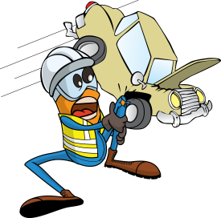
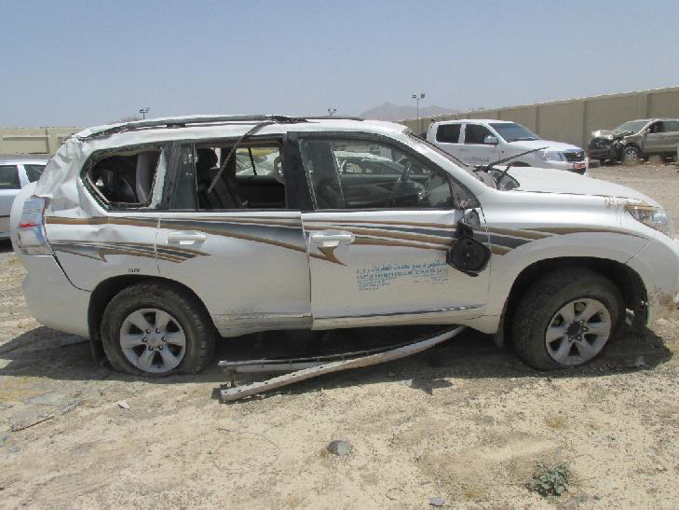
PDO Incident First Alert
Incident type | MVI Rollover LTI (#26) | PIM ID | 1094593
Date/ time | 02.09.2016 (12:00 hrs) | Directorate
Location | Manah Road | Dept
What happened
A contractor Operations Manager was driving on the Manah road between Fahud to Muscat when he lost control of the vehicle causing it to rollover multiple times resulting in a fracture to his left arm.
Mr. Musleh asks the questions of can it happen to you?
Do you inspect your vehicle before you start your journey?
Do you always wear your seatbelt ?
Do you continue driving if you are fatigued?
Please disseminate this LTI notification to your teams and use it in your tool box talks and HSE meetings and notice boards.

