Slide 1
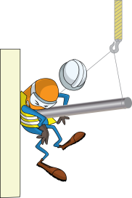
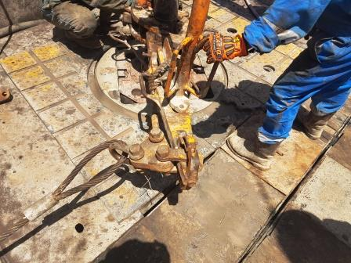
PDO Incident First Alert
Incident type | LTI (#28) | PIM ID | 1094732
Date/ time | 11.09.2016 at 11:50 hrs. | Directorate
Location | Rig 108 Nimr | Dept
What happened
While pulling out of the hole the rig crew used two tongs to break out the joint. As the joint disconnected the bottom tong swung away striking a floorman resulting in a fracture to his left leg.
Mr. Musleh asks the questions of can it happen to you?
Do you ensure you are standing in a safe position when Pulling out of Hole?
Do you consider if you are in the ‘line of fire’?
Do you understand where stored energy will come from?
Please disseminate this LTI notification to your teams and use it in your tool box talks and HSE meetings and notice boards.

