Slide 1
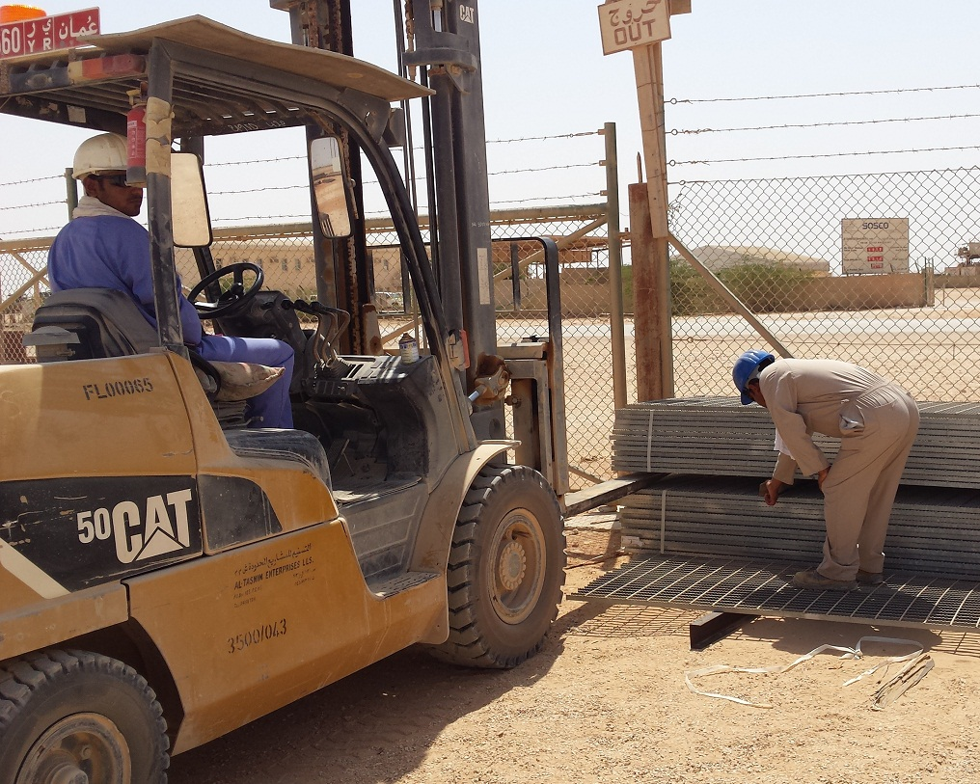
PDO Incident First Alert
Incident type | LTI (#29) | PIM ID | 1094709
Date/ time | 14.09.2016 at 09:45 hrs. | Directorate
Location | ATE yard in Nimr | Dept
What happened
While a bundle of gratings was being lowered by forklift, the banksman placed his right hand on top of the wooden dunnage between the bundles. As the load was lowered his right hand thumb was crushed resulting in a partial amputation.
Mr. Musleh asks the questions of can it happen to you?
Are you authoirised to carry out the task?
Do you ensure you keep your hands away from crush points?
Do you consider if you are in the ‘line of fire’?
Do you ensure you are wearing the correct gloves for the task?
Please disseminate this LTI notification to your teams and use it in your tool box talks and HSE meetings and notice boards.

