Slide 1

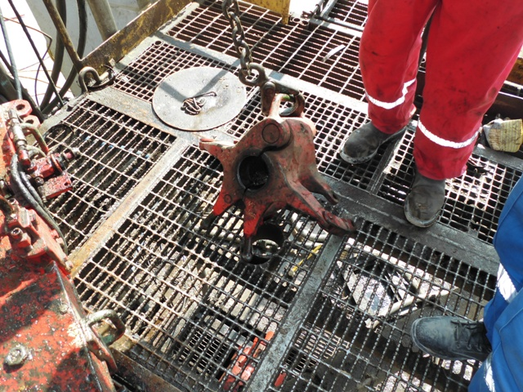


PDO Incident First Alert
Incident type | LTI (#31) | PIM ID | 1094778
Date/ time | 22.09.2016 at 09:15 hrs. | Directorate
Location | Hoist 13 - Lekhwair | Dept
What happened
The crew wanted to re-spool the drill line on the drum which had come loose. They connected the winch line to the elevator and then undid the elevator bolts, but because of slack in the winch line the elevator dropped 1m onto his left foot breaking a bone in his foot.
Mr. Musleh asks the questions of can it happen to you?
Do you ensure that all weights are supported before removing the supporting bolts?
Do you ensure wire ropes are spooled correctly on the drum?
Do you consider if you are in the ‘line of fire’?
Please disseminate this LTI notification to your teams and use it in your tool box talks and HSE meetings and notice boards.

