Slide 1
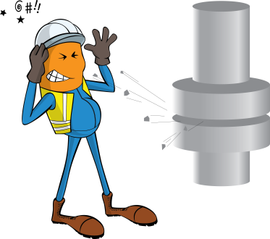
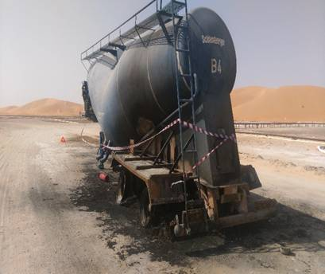
PDO Incident First Alert
Incident type | LTI (#30) | PIM ID | 1094727
Date/ time | 16.09.2016 at 22:30 hrs. | Directorate
Location | Lekhwair – near rig 99 | Dept
What happened
While attempting to extinguish a wheel fire on a trailer using the trucks fire extinguisher, a rubber covering which is part of the wheels braking system exploded due to the fires intense heat and a piece of this rubber struck the driver in the face.
Mr. Musleh asks the questions of can it happen to you?
Do you check your trucks warning gauges regularly for air pressure?
Do you report any issues with brakes immediately to maintenance?
Do you regularly check your trailer in the mirrors?
Please disseminate this LTI notification to your teams and use it in your tool box talks and HSE meetings and notice boards.

