Slide 1
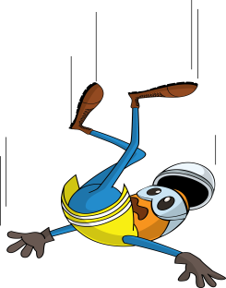
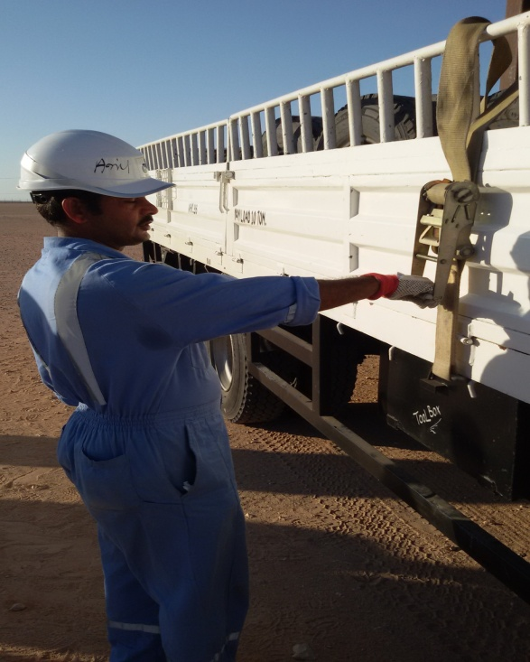


PDO Incident First Alert
Incident type | LTI (#32) | PIM ID | 1094848
Date/ time | 28.09.2016 at 15:20 hrs. | Directorate
Location | Bahja yard | Dept
What happened
A store assistant was securing gas cylinders in a HIAB. While tightening the ratchet strap, the ratchet sprung open causing him to loose his balance and fall backwards resulting in fractures to both wrists.
Mr. Musleh asks the questions of can it happen to you?
Do you check your load security belts and ratchets before use?
Do you keep a solid stance when working?
Ratchet came loose causing store assistant to fall backwards
Please disseminate this LTI notification to your teams and use it in your tool box talks and HSE meetings and notice boards.

