Slide 1
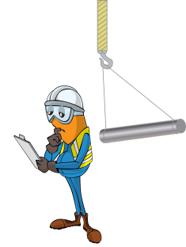
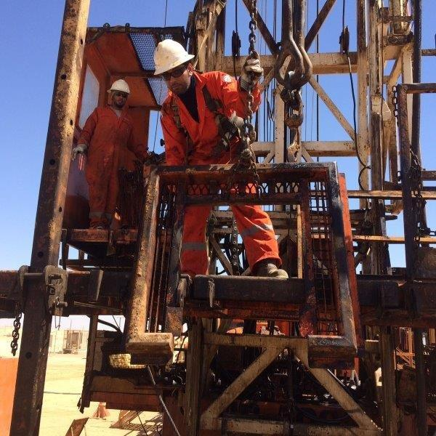
PDO Incident First Alert
Incident type | LTI (#33) | PIM ID | 1094854
Date/ time | 29.09.2016 at 08:00 hrs. | Directorate
Location | Hoist 68 Marmul | Dept
Winch line under tension
What happened
A roustabout was raising the rig floor slips cover using a winch line when it became snagged on a pad eye. The slips which were now under tension came free from the pad eye striking the roustabout in the face resulting in trauma to his upper lip.
Mr. Musleh asks the questions of can it happen to you?
Do you ensure you handle suspended loads with a tag line?
Do you always ensure you are out of the lifting zone?
Do always consider if you are in the line of fire?
Flooring caught on Pad eye
Please disseminate this LTI notification to your teams and use it in your tool box talks and HSE meetings and notice boards.

