Slide 1
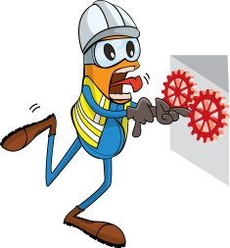
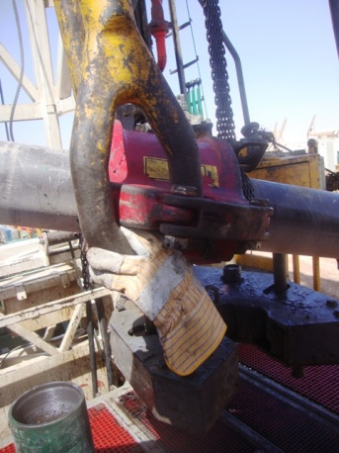


PDO Incident First Alert
Incident type | LTI (#34) | PIM ID | 1094782
Date/ time | 23.09.2016 at 07:30 hrs. | Directorate
Location | Hoist 103 Nimr | Dept
Elevator
Sling
What happened
After hooking the casing joint to the elevator, the floorman attempted to remove the sling from the joint before the driller had fully lowered it. His hand became trapped between the elevator and elevator links crushing his left hand index finger.
Mr. Musleh asks the questions of can it happen to you?
Do keep your hands and fingers away from crush points?
Do you always ensure you are out of the lifting zone?
Do always consider if you are in the line of fire?
Please disseminate this LTI notification to your teams and use it in your tool box talks and HSE meetings and notice boards.

