Slide 1
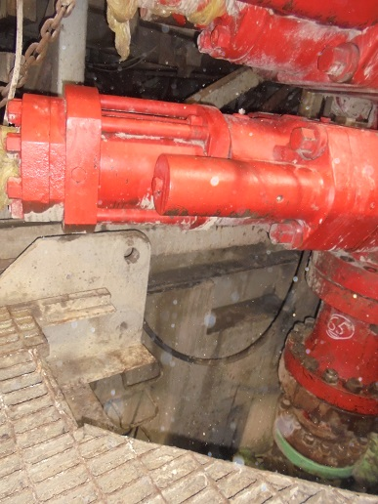
PDO Incident First Alert
Incident type | LTI (#35) | PIM ID | 1094921
Date/ time | 03.10.2016 at 20:30 hrs. | Directorate
Location | Rig 48, Bahja area | Dept
What happened
While climbing out of the cellar the Roustabout placed his hand on the pad eye of the sub base lower beam. At the same time, a floorman operated the Blow Out Preventer (BOP) hoist winch resulting in the BOP tilting at one end trapping the Roustabout’s right hand thumb between the pad eye and sheer ram bonnet, resulting in a fracture to his right hand thumb.
Mr. Musleh asks the questions of can it happen to you?
Do you ensure the work area is clear before carrying out lifting operations?
Do you ensure effective communication with your work colleagues?
Do you ensure you have safe access & egress?
Point where thumb was trapped
Please disseminate this LTI notification to your teams and use it in your tool box talks and HSE meetings and notice boards.

