Slide 1
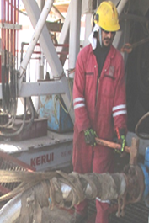
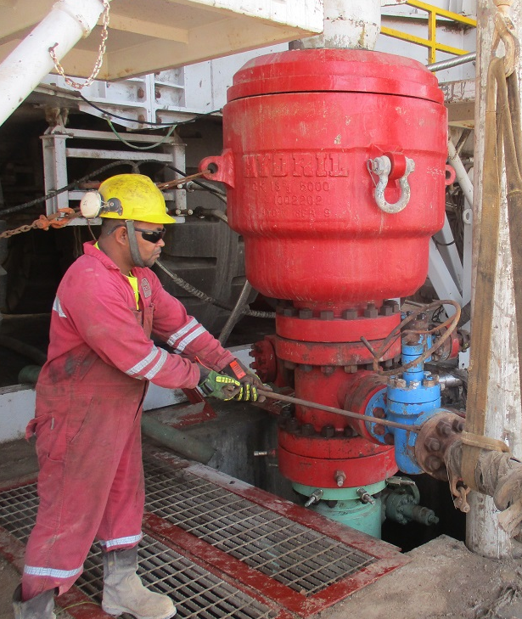
PDO Second Alert
Date: 23.04.16 LTI RIG 97
What happened:
A team were attempting to remove the choke line hose (CLH) from the BOP with the help of a forklift truck. When they found the CLH was stuck, the Night Tool Pusher instructed the floor man to collect a pry bar. While the team were waiting for the pry bar, the derrick man tried to release the CLH, using a sledge hammer. Whilst hitting the flange with the hammer, the CLH became free dropping on his left foot.
Your learning from this incident..
Use the correct securing method for the task.
Ensure the correct equipment is used for the task.
Ensure you stay out of the line of fire.
Always keep a safe distance from the load with a potential to drop.
IP’s foot was below the choke line, when it fell from 0.5m height from the flange.
Stay out of the line of fire
Choke hose vertically secured.
Safe distance maintained.

Slide 2
Management self audit
Date: 23.04.16 LTI RIG 97
As a learning from this incident and to ensure continual improvement, all contract managers must review their HSE HEMP against the questions asked below:
Confirm the following:
Do you have an effective TBT with TRIC and JSP to cover all the hazards / risks and controls for the task?
Do your crew understand “Line of Fire” related risks?
Do you ensure your crew are not using the crane/fork lift to pull the load?
Do you have an effective audit/assurance process to identify shortfalls in your risk management tool JSP/JSAs?
Notes:
Make a list of closed questions (only ‘yes’ or ‘no’ as an answer) to ask other contractors if they have the same issues based on the management or HSE-MS failings or shortfalls identified in the investigation. Pretend you have to audit other companies to see if they could have the same issues.

