Slide 1
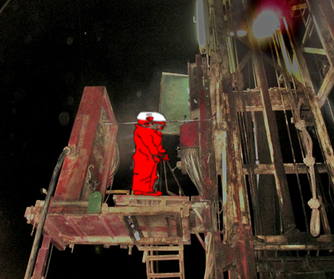
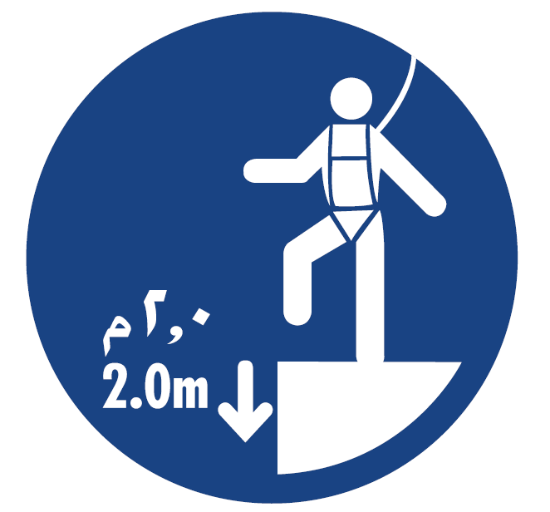
PDO Second Alert
Date: 01.05.16 LTI Fahud
What happened?
During Hoist Rig down and in the process of removing driller console shade, the Driller attached the forklift boom hook to the shade post and then signaled to Forklift operator to lift the shade. Once the post came out from its base, the shade tilted and came in contact with Driller, resulting in him losing his balance and falling from a height of 3.5 meters to the ground. The crew immediately went to his aid and administered First aid. Thereafter, he was transported to PDO Fahud clinic.
Your learning from this incident..
Always use fall protection equipment while working at height.
Plan your jobs to minimize hazards and risks.
Ensure home made tools/equipment are not used on site.
Supervisors to always supervise their crew members.
Intervene if you see unsafe acts or conditions.
Do not work at height without fall protection

Slide 2
Management self audit
Date: 01.05.16 LTI Fahud
As a learning from this incident and to ensure continual improvement, all contract managers must review their HSE HEMP against the questions asked below:
Confirm the following:
Do management check for home made tools during their site visits?
Do you ensure all the learning from incidents are used to update your procedure?
Do you have working at height procedure?
Are your personnel aware that they should use fall protection when working near unprotected edges?
Do you formally check compliance with the management of change procedure?
Notes:
Make a list of closed questions (only ‘yes’ or ‘no’ as an answer) to ask other contractors if they have the same issues based on the management or HSE-MS failings or shortfalls identified in the investigation. Pretend you have to audit other companies to see if they could have the same issues.

