Slide 1
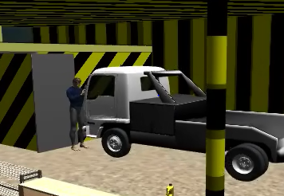
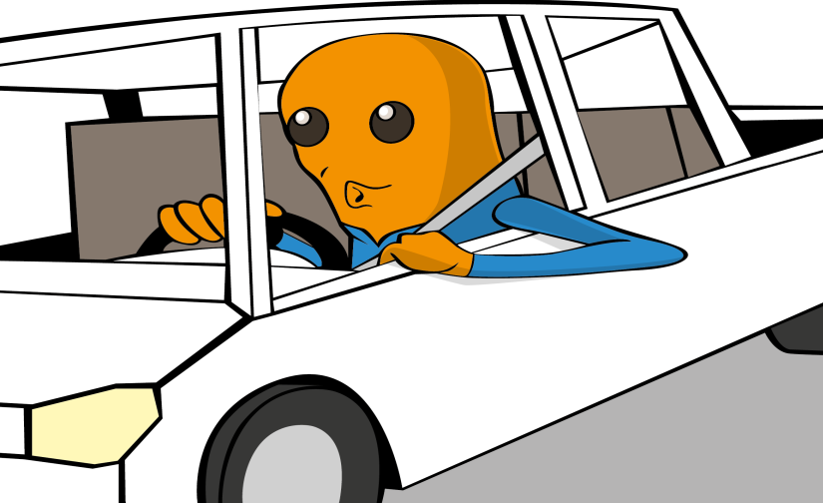
PDO Second Alert
Date: 03.05.2016 LTI Nimr
What happened?
Mechanics were working in the vehicle workshop area to repair the A/C system on a light vehicle. Upon completion of the job, the vehicle was started from the outside whilst still in gear. The vehicle then moved forward and crushed the second mechanic who was standing in front of the vehicle and in the “line of fire”. This resulted in multiple pelvis injuries and broken hip bone.
Your learning from this incident…
Do not start a vehicle from the outside.
Do not start a vehicle while in gear.
Do not stand in the “line of fire”.
Do not attend the working areas where you are not assigned to do the job.
Always intervene and stop any unsafe act.
Always start a vehicle correctly

Slide 2
Management self audit
Date: 03.05.2016 LTI Nimr
As a learning from this incident and to ensure continual improvement, all contract managers must review their HSE HEMP against the questions asked below:
Confirm the following:
Are all risks related to the vehicle workshop activities identified, assessed and reflected in the Contract HEMP?
Are all vehicle mechanics trained and following the safe working practices?
Are workshop supervisors constantly present on site and supervising the jobs in progress?
Do the employees know what is the “line of fire” and are they observing safety critical behaviors?
Are all working areas clearly marked to ensure unassigned personnel are not present there while work is in progress?
Notes:
Make a list of closed questions (only ‘yes’ or ‘no’ as an answer) to ask other contractors if they have the same issues based on the management or HSE-MS failings or shortfalls identified in the investigation. Pretend you have to audit other companies to see if they could have the same issues.

