Slide 1
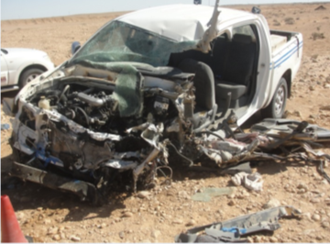
PDO Second Alert
Date: 08.5.2016 MVI Fatality
What happened?
At 05:37, a pickup truck was travelling from Nimr to Marmul. On the way the driver veered over the centre line and struck an oncoming 3rd party heavy truck killing the pickup driver. The driver had departed on a unauthorised journey from Nimr prior to working hours and without a journey plan.
Your learning from this incident..
Always adhere to Journey Management procedures.
Ensure you have adequate rest, don’t drive if you are tired.
Don’t drive outside of working hours.
Always ensure your journey is authorised

Slide 2
Management self audit
Date: 08.5.2016 MVI fatality
As a learning from this incident and to ensure continual improvement, all contract managers must review their HSE HEMP against the questions asked below:
Confirm the following:
Do you have a Journey Management procedure that clearly states what time drivers should start?
Do you have a system that informs you if someone is driving outside of working hours?
Do you ensure drivers have sufficient rest?
Notes:
Make a list of closed questions (only ‘yes’ or ‘no’ as an answer) to ask other contractors if they have the same issues based on the management or HSE-MS failings or shortfalls identified in the investigation. Pretend you have to audit other companies to see if they could have the same issues.

