Slide 1
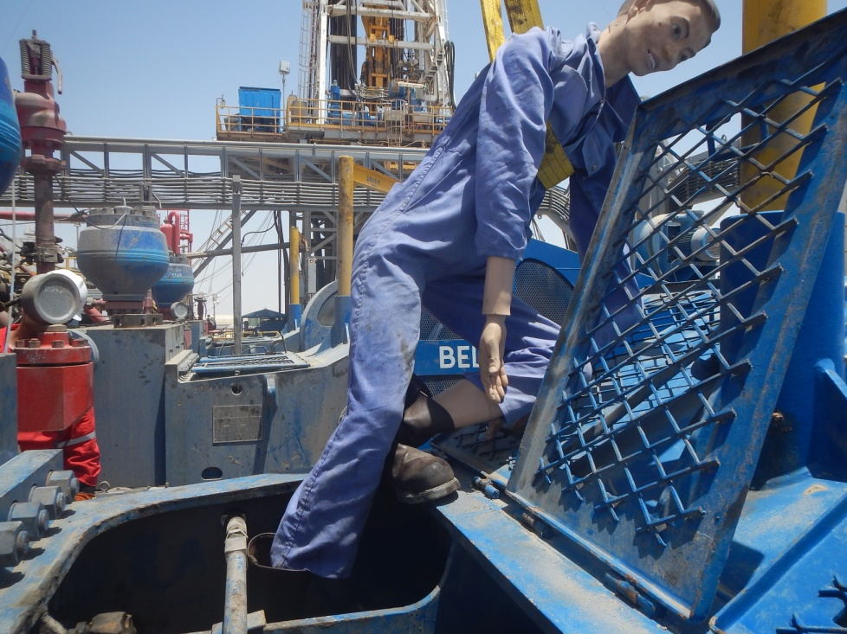
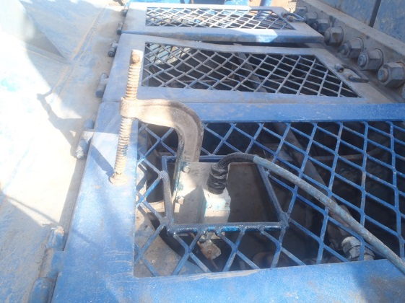
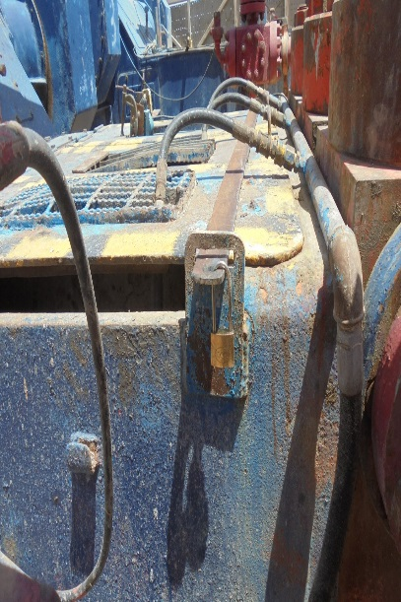
PDO Second Alert
Date: 08.05.2016 LTI Qarn Alam
What happened?
At 02:07 hrs am while cleaning mud pump # 2 using wash gun, trainee Night Tool Pusher was standing on top of the mud pump while it was running and the piston cover was open. He slipped, lost his balance and his right foot came in contact with the piston clamp and liner resulting in a fracture to his right foot.
Your learning from this incident..
Supervisors to maintain adequate supervision at all times.
Intervene if you see unsafe acts or conditions.
Always report any defect or faults in safety devices/designs.
Never climb or stand on the top of mud pump while in operation.
Piston cover shall always be kept closed.
Ensure all safety covers and guards are secured and in place

Slide 2
Management self audit
Date: 08.05.2016 LTI Qarn Alam
As a learning from this incident and to ensure continual improvement, all contract managers must review their HSE HEMP against the questions asked below:
Confirm the following:
Are piston covers under lock in your organization?
Do your supervisors have clear instructions not to work hands on?
Is there any need to be on top of mud pump for cleaning?
Notes:
Make a list of closed questions (only ‘yes’ or ‘no’ as an answer) to ask other contractors if they have the same issues based on the management or HSE-MS failings or shortfalls identified in the investigation. Pretend you have to audit other companies to see if they could have the same issues.

