Slide 1
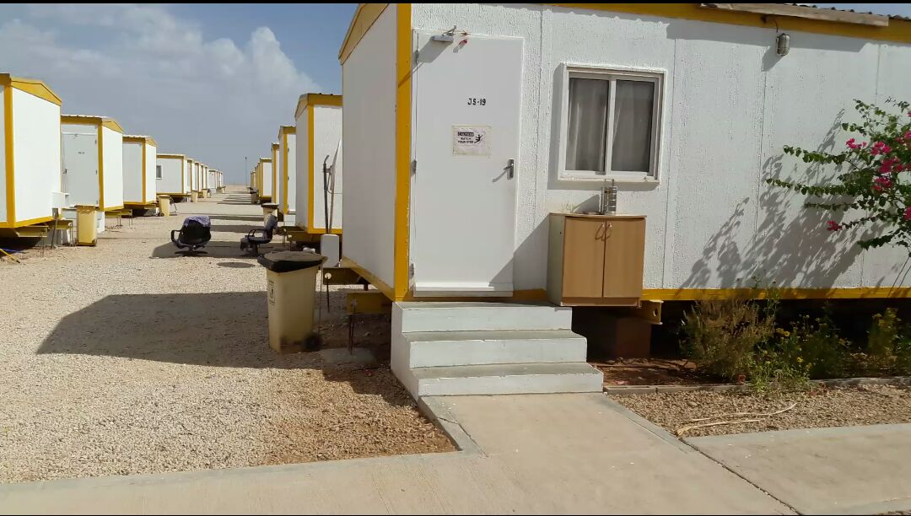
PDO Second Alert
Date: 01.05.16 LTI Harweel
What happened?
Staff stepped down diagonally to the right, landing his right foot on the raised edge of the walkway and fell on landing on his right hip.
Your learning from this incident..
Walkways with raised edges are potential Hazard.
Walk in the middle of the walk ways.
Beware of raised edges of walk ways.

Slide 2
Management self audit
Date: 01.05.16 LTI Harweel
As a learning from this incident and to ensure continual improvement, all contract managers must review their HSE HEMP against the questions asked below:
Confirm the following:
Are there warning signage on raised edges of the walkways immediately near to stairs?
Are staff aware of the steps’ and walkway raised edges’ hazards in their work place and accommodation areas?
Do the walkways and steps comply to the design in SP-1275?
Notes:
Make a list of closed questions (only ‘yes’ or ‘no’ as an answer) to ask other contractors if they have the same issues based on the management or HSE-MS failings or shortfalls identified in the investigation. Pretend you have to audit other companies to see if they could have the same issues.

