Slide 1
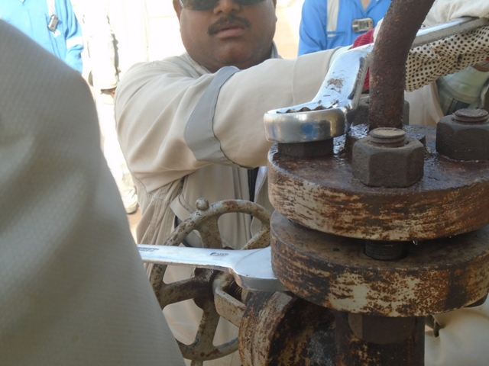
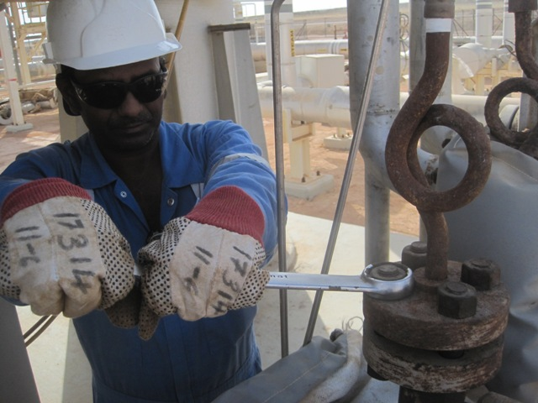
PDO Second Alert
Date: 11.06.16 LTI Amal
What happened?
Whilst loosening nuts on a flange using a ring spanner, it slipped off the nut as the fabricator applied force to it, causing him to loose balance and fall to the ground fracturing his left wrist and right elbow.
Your learning from this incident..
Ensure spanners used fits correctly for loosening/tightening nuts.
Ensure you have good balance when using tools.
Phto explaining what was done wrong
Photo explaining how it should be done right
Use right tools for the job and use them correctly

Slide 2
Management self audit
Date: 11.06.16 LTI Amal
As a learning from this incident and ensure continual improvement all contract
managers must review their HSE HEMP against the questions asked below
Confirm the following:
Do you ensure that all maintenance activities are carried out by using the right tools designed for the task?
Do you ensure you have good balance when you are using tools?
Do you ensure that all your personnel understand the hazards associated with the tasks performed by them and takes effective control measures to ensure the risk associated with the hazard is made ALARP?
Do you ensure that all personnel use the empowerment to STOP in case they see any job not done in a safe manner?
Notes:
Make a list of closed questions (only ‘yes’ or ‘no’ as an answer) to ask other contractors if they have the same issues based on the management or HSE-MS failings or shortfalls identified in the investigation. Pretend you have to audit other companies to see if they could have the same issues.

