Slide 1
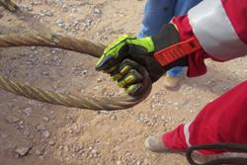
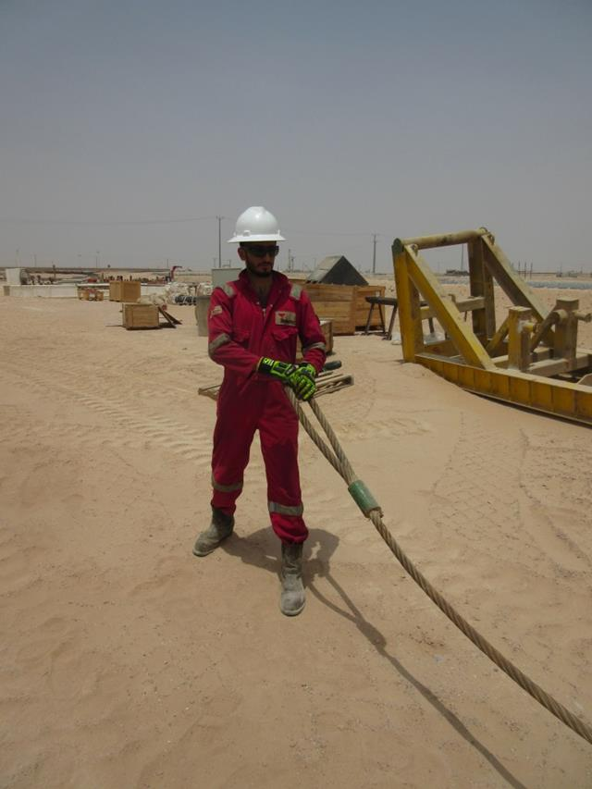
PDO Second Alert
Date: 21.06.2016 LTI Qarn Alam
What happened?
The roustabout was working on the catwalk attaching the wire rope sling to the Top-drive from the blocks. The Floor man on the rig floor lowered the wire rope slings down the v-door and onto the catwalk. The roustabout proceeded to attach the wire rope sling but wasn’t aware that it was twisted (and had stored energy), so he pulled the wire rope sling, as he did this the sling unwound and struck his hand fracturing a bone.
Your learning from this incident..
Always check if slings are twisted before pulling.
Always monitor your new employees (SSE) and allow them to perform a task only if they are competent to do so.
Communicate with Driller/AD to remove any twist in the sling.
Be aware and understand any stored energy hazard.
Don’t pull a twisted sling

Slide 2
Management self audit
Date: 21.06.2016 LTI Qarn Alam
As a learning from this incident and to ensure continual improvement, all contract managers must review their HSE HEMP against the questions asked below:
Confirm the following:
Do you have a robust Short Service Employee (SSE) program in place? Is it implemented correctly? How do you verify the implementation of the SSE program?
Are your employees competent on correct manual handling techniques?
Do you involve your workforce in the development of the rig specific SOP’s and risk assessments?
Are your SOP’s updated regularly?
Notes:
Make a list of closed questions (only ‘yes’ or ‘no’ as an answer) to ask other contractors if they have the same issues based on the management or HSE-MS failings or shortfalls identified in the investigation. Pretend you have to audit other companies to see if they could have the same issues.

