Slide 1
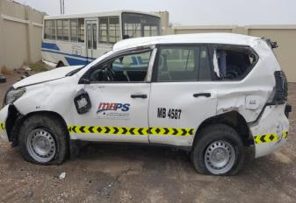
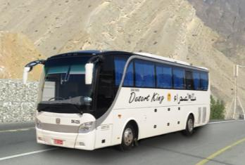
PDO Second Alert
Date: 29.06.2016 MVI: Fatality
What happened?
At 13:30 hrs a supervisor was driving to Qarn Alam from Muscat in a Company Prado. 90 minutes into the journey, he drifted off the dual carriageway and when he over steered in an attempt to regain control the vehicle rolled over multiple times and the drivers head hit the side window frame killing him.
Your learning from this incident..
Stay alert at all times when driving, don’t get distracted.
If you drift off the road, do not over react, slow down steadily and only steer back on to the road gently.
Never use your mobile phone whilst driving a vehicle.
Make sure your journey complies with the 200km maximum light vehicle journey.
Avoid light vehicle journeys to and from the coast, use the bus instead

Slide 2
Management self audit
Date: 29.06.2016 MVI: Fatality
As a learning from this incident and to ensure continual improvement, all contract managers must review their HSE HEMP against the questions asked below:
Confirm the following:
Do you enforce the SP-2000 requirements to authorize LV journey’s over 200 kilometers?
Does your audit plan cover SJM compliance?
Does your system verify the competency of the journey manager?
Does your system verify the appointed person is fulfilling his role?
Notes:
Make a list of closed questions (only ‘yes’ or ‘no’ as an answer) to ask other contractors if they have the same issues based on the management or HSE-MS failings or shortfalls identified in the investigation. Pretend you have to audit other companies to see if they could have the same issues.

