Slide 1
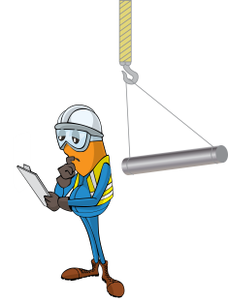
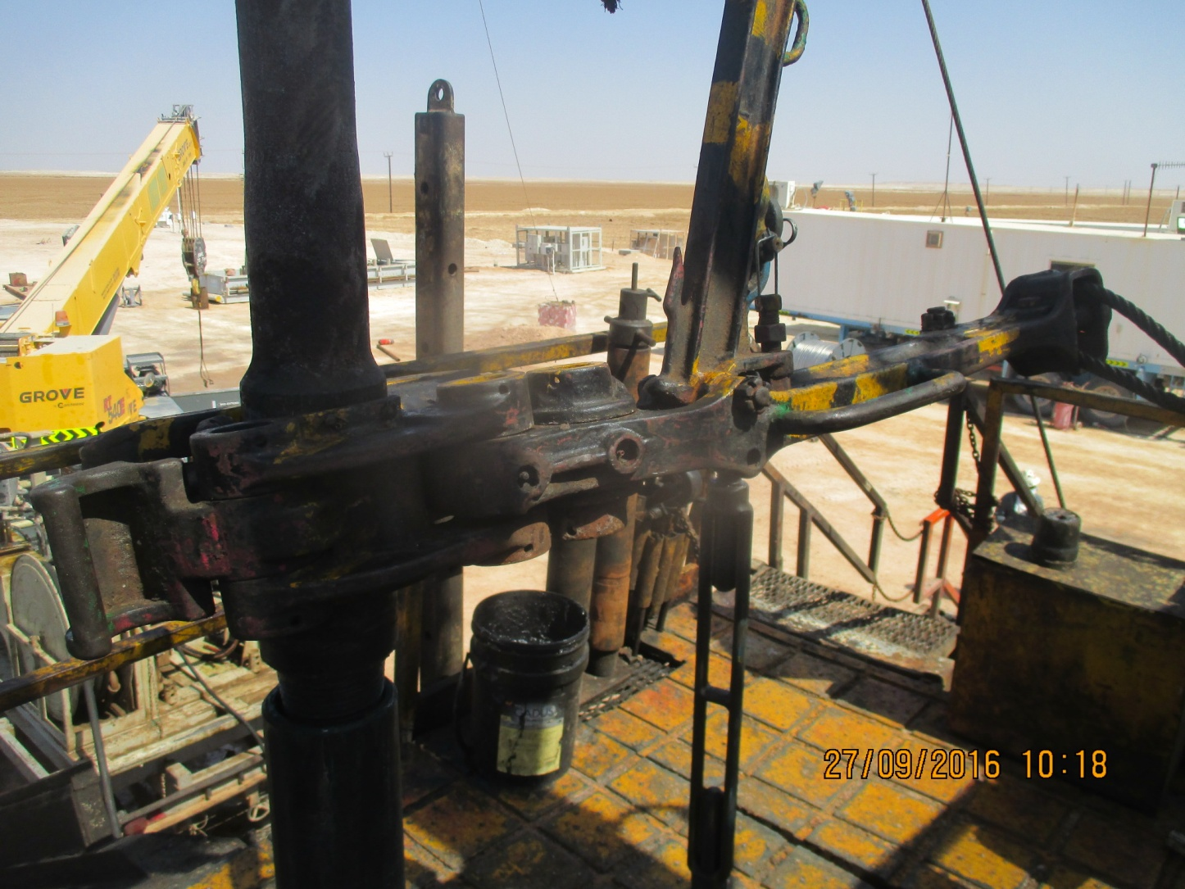


PDO Incident First Alert
Incident type | LTI (#36) | PIM ID | 1094831
Date/ time | 27.09.2016 at 10:10 hrs. | Directorate
Location | Hoist 50 Yibal | Dept
What happened
After attaching the manual tong above the power swivel while disconnecting the drill pipe, the red zone was cleared to allow the breakout torque to be applied. The driller observed the floorman step into the red zone just as the connection broke loose hitting the floorman on the left side of his face.
Mr. Musleh asks the questions of can it happen to you?
Do you ensure you are standing in a safe position when braking the joint?
Do you stay out of the red zone during operations?
Do you understand where stored energy will come from?
Do you consider if you are in the ‘line of fire’?
Joint swung out from the tongs hitting the floorman.
Please disseminate this LTI notification to your teams and use it in your tool box talks and HSE meetings and notice boards.

