Slide 1
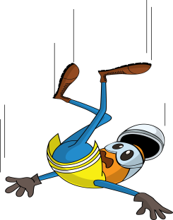
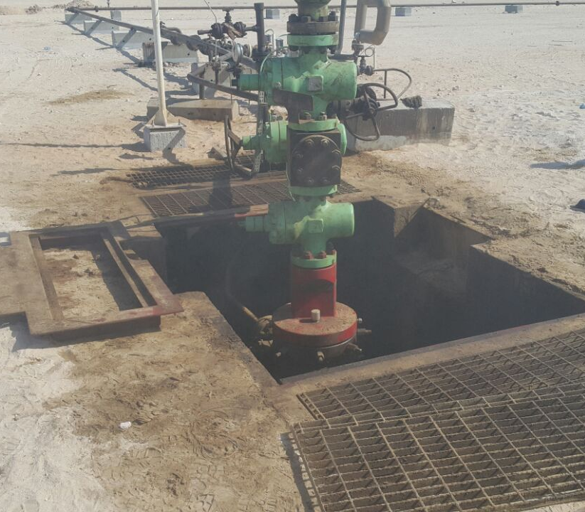


PDO Incident First Alert - PDO
Incident type | LTI (#37) | PIM ID | 1095200
Date/ time | 27.10.2016 at 13:00 hrs. | Directorate
Location | Zareef-13, bahja | Dept
What happened
Whilst assisting two station operators in the preparation of re-commissioning the well, a helper stepped on to the cellar grating frame which was loose and fell into the cellar hitting his head on the gratings.
Mr. Musleh asks the questions of can it happen to you?
Do you ensure you are in a safe position when working close to an opening?
Do you always consider if you can fall from height?
Do you ensure you have safe access to cellars?
Helper slipped on loose grating frame falling into the cellar
Please disseminate this LTI notification to your teams and use it in your tool box talks and HSE meetings and notice boards.

