Slide 1
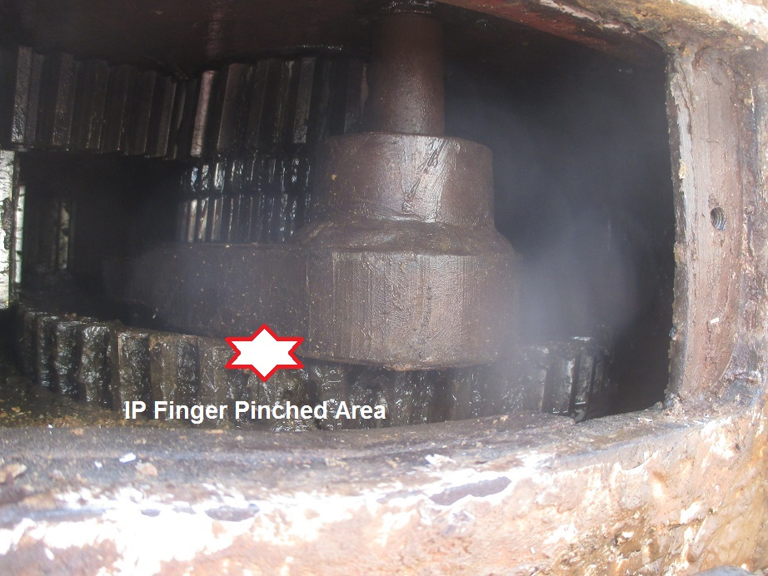
PDO Incident First Alert
Incident type | LTI (#38) | PIM ID | 1095395
Date/ time | 10.11.2016 at 20:15 hrs. | Directorate
Location | Ameen | Dept
What happened
While working on the Farr tong gear shifter a mechanic noticed a loose nut on the shifter mechanism and placed his left hand in between the gear and the shifting mechanism resulting in his middle finger being crushed and the tip being amputated.
Mr. Musleh asks the questions of can it happen to you?
Do you make sure the equipment is isolated before you work on it?
Do you keep your hands and fingers away from pinch points?
Do you use the correct tools for the job?
Do you consider if your fingers are in the “line of fire?”
Farr tong gear mechanism
Please disseminate this LTI notification to your teams and use it in your tool box talks and HSE meetings and notice boards.

