Slide 1
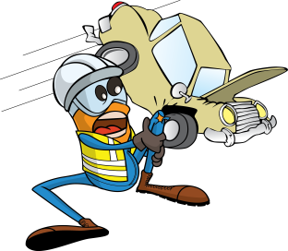
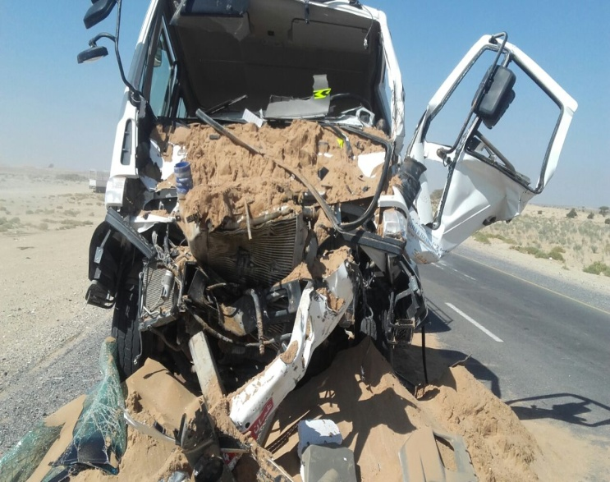


PDO Incident First Alert
Incident type | LTI (#39) | PIM ID | 1095440
Date/ time | 15/11/2016 (09:50 hrs) | Directorate
Location | Natih Road | Dept
What happened
A water tanker was driving behind a 3rd party tipper truck on the Natih road from Fahud. The tipper truck driver reduced speed due to camels crossing the road, however the tanker driver failed to stop and continued into the rear of the tipper truck He sustained a fracture to the left leg.
Mr. Musleh asks the questions of can it happen to you?
Do you keep a safe distance from the vehicle in front?
Do you always adjust your speed to the road conditions?
3. Do you apply defensive driving techniques?
Please disseminate this LTI notification to your teams and use it in your tool box talks and HSE meetings and notice boards.

