Slide 1
Repeat Incidents Engagement Pack
Notes:
The reason for this work stoppage is to highlight the fact that PDO and its contractors are having many repeat incidents, the majority of which could be avoided!
Emphasise this is about repeat incidents………….repeat yourself so make the point about repeating.

Slide 2
STOP making excuses!
‘It’s time for action’
“Together we can solve any problem !!”
Notes:
Everyone is busy.
Everyone is working hard.
Everyone wants to do their job and go home safe.
BUT not everyone is doing their job safely.
Lets STOP MAKING EXCUSES!

Slide 3
Are we learning from
incidents?
Notes:
Ask the people that you are presenting this work stoppage to give you their personal opinions…………..
If they say yes or no, ask them to justify their answers as to why they believe their answer to the right one.
Have a 5 – 10 minute engagement before moving onto the next slide.
Ask the following questions:
What do you think are the top 3 incidents in your work area? (The person delivering should know what they are.)
How do you think they could have been prevented?

Slide 4
The following slides would suggest
we are not!
Notes:
Simply show them this slide pausing to let it sink in before moving on to the next questions.
Do you know why “we are not”? (Because we’re still having them AND we keep repeating the same mistakes)

Slide 5
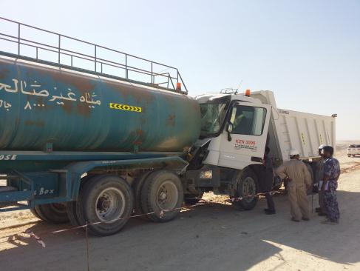
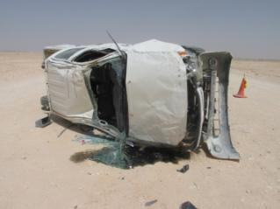
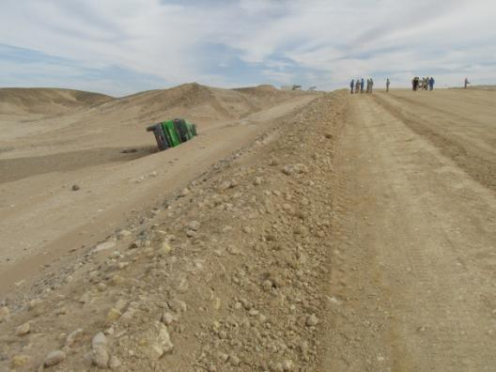
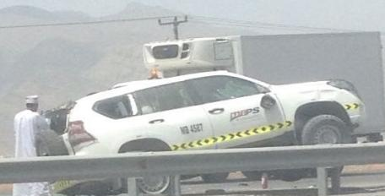
Motor Vehicle Incidents (MVI)
Repeat تكرار
Notes:
Ask the attendees:
Why they think these things happen……………there is no right or wrong answers, it is more about engagement and getting people talking and thinking about the consequences of not paying attention on the roads.
How many people here drive without seat belts?
How many people here answer a call on their GSM for a few seconds?
How many people here have driven long distances while tired?
Here are just 4 examples of MVI’s.
1. Oct 2016 A water tanker deployed for sprinkling water on a graded road. A tipper hit rear end of the tanker resulting in major damages to the tipper.
2. May 2016 A pick-up driver with one passenger lost control, resulting in the vehicle rolling over multiple times.
3. Feb 2016 A tanker parked on a slope moved backwards and tipped over into the ditch, 8m deep.
4. Jun 2016 A Prado driver lost control on the Muscat Nizwa highway rolling over losing his life.
DON’T BE THE NEXT VICTIM!
Instead of repeating the mistakes, try repeating “doing the right thing” and this will become your habit.

Slide 6
Motor Vehicle Incidents (mvi)
Repeat تكرار
Notes:
Between January 2015 and October 2016 (22 months)
PDO & its contractors have suffered 163 Motor Vehicle Incidents (MVI)
50 resulted in a roll over,
45 of these incidents were from rear shunts.
Ask them if they know what a rear end shunt is and get someone in the crowd to explain it.

Slide 7
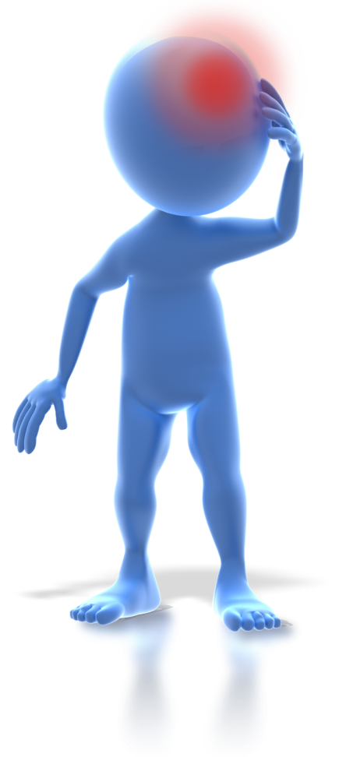
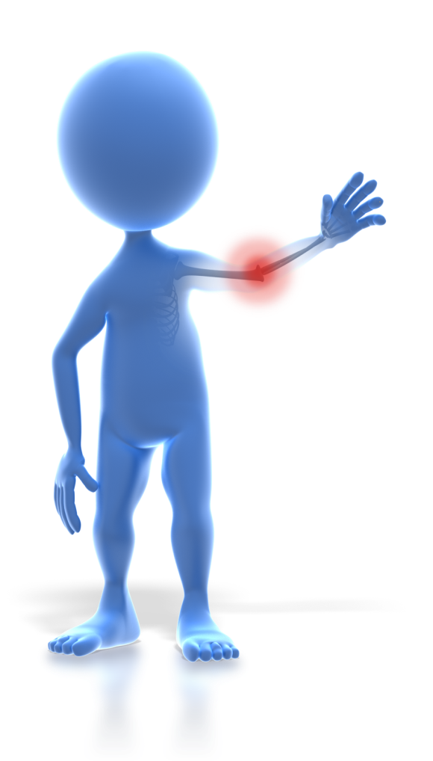
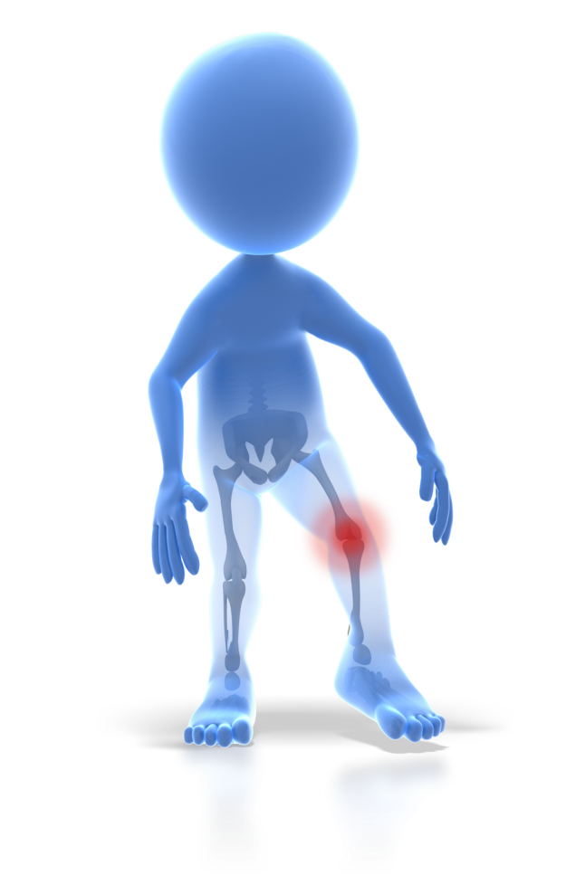
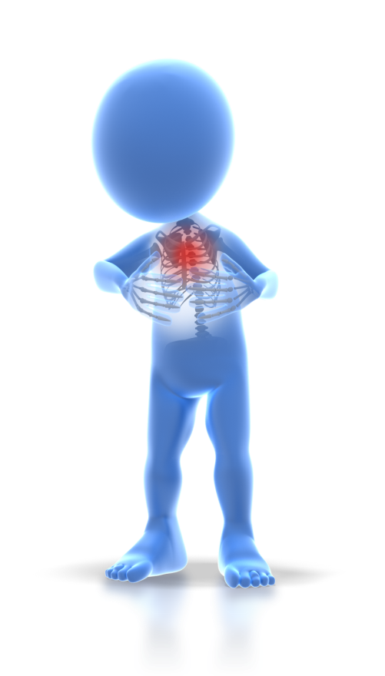
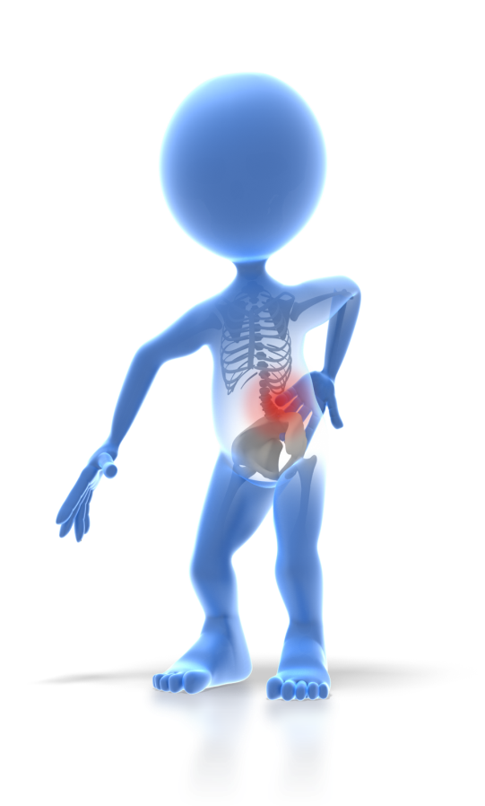
Bones
Our families, friends & colleagues have broken many of them
Repeat تكرار
Notes:
Questions: How many bones do you think an adult human has?
Answer: The human skeleton has 206 bones by adulthood.
Ask the people attending…………………….
Do you know of anyone who has been injured at work?
Did any of them result in a fracture?
How did it affect their lives or the lives of their families?
People always have stories to share.

Slide 8
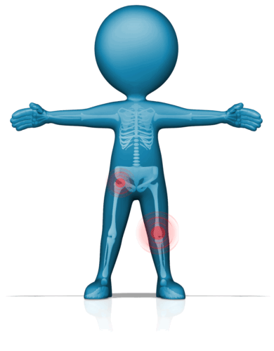
HOW MANY HAVE WE fractured?
49% to be exact!
Adult has 206 bones
January 2015 – October 2016
Repeat تكرار
Notes:
Select a person from the attendees to come stand with you at the front as you explain the next points
So as we said, an adult human has 206 bones in their body
Between January 2015 – October 2016 PDO and its contractors had 88 LTI’s
And they resulted in 100 fractured bones
Using the person at the front, explain……………That means that we have broken 49% of all of the bones in this persons body.
Ask the attendees the questions……………..
Do you think that is acceptable? No, neither do we!
Why is this not acceptable?

Slide 9
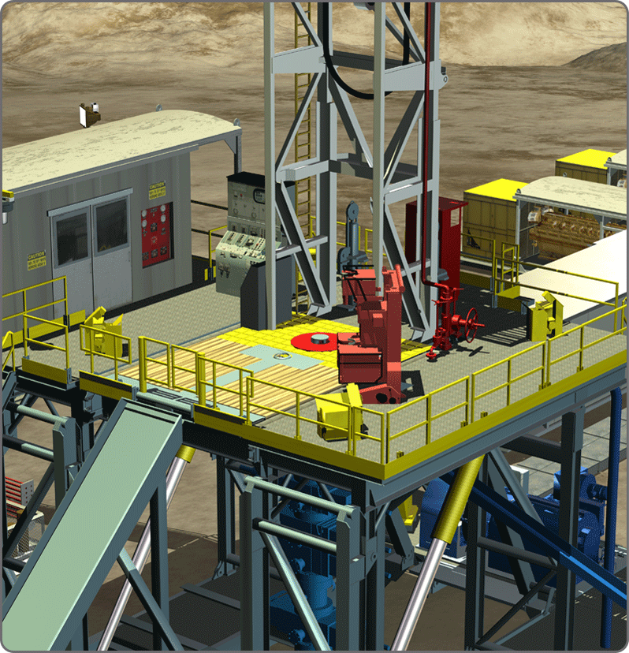
Hands And fingers in Well Engineering
H & F January 2015 – October 2016
All these incidents Happened on Rig floor
Repeat تكرار
Notes:
Where are these injuries happening? Answer is : All of the above incidents happened on rig floor
Why do you think we keep making the same mistakes?
From Jan to December 2015, 24 hands and fingers injures. include Restricted work Case (RWC) Medical Treatment Cases (MTC) and Lost Time incidents (LTIs) .
Jan to Oct 2016 ,13 hands and fingers injures. include Restricted work Case (RWC) Medical Treatment Cases (MTC) and Lost Time incidents (LTIs) .
Although it is a reduction its still a high number of similar incidents

Slide 10
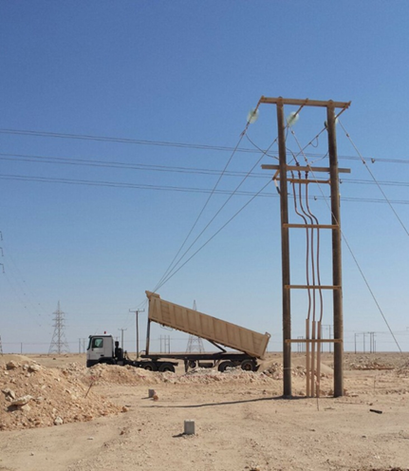
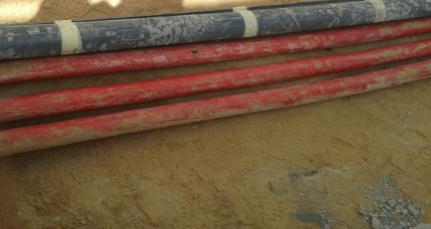
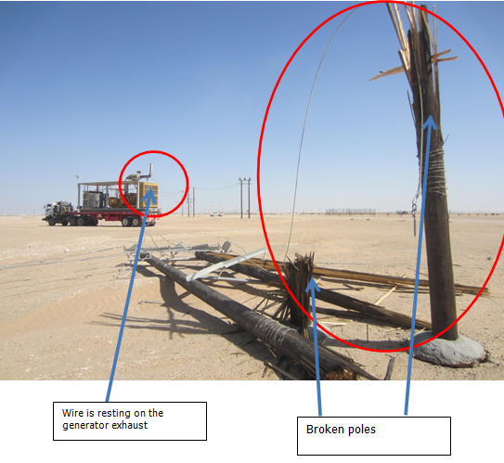
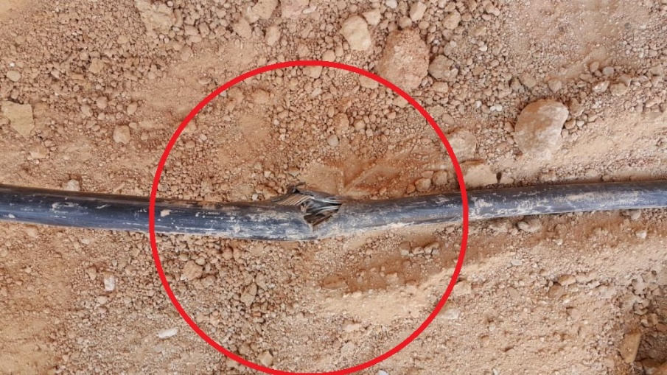
Over Head Line Strikes & excavation
Repeat تكرار
Notes:
Ask the attendees:
Why they think these things happen……………
Here are just 4 examples of overhead strikes and excavation related incidents
1. Nov 2015 A tipper driving with the body raised made contact with an Over Head Line – Reason: the body was raised
2. Aug 2016 While completing a foundations task a cable was punctured tripping a main power station – Reason: Cable protection had been removed
3. Sep 2015 During a rig move a winch truck with the Rig generator made contact with an Over Head Line. - Reason: Driver diverted from the approved route
4. Aug 2016 Back-hoe bucket teeth punctured the insulation of HV cable while doing mechanical excavation tripping the station. – Reason: Cable in location NOT marked on map

Slide 11
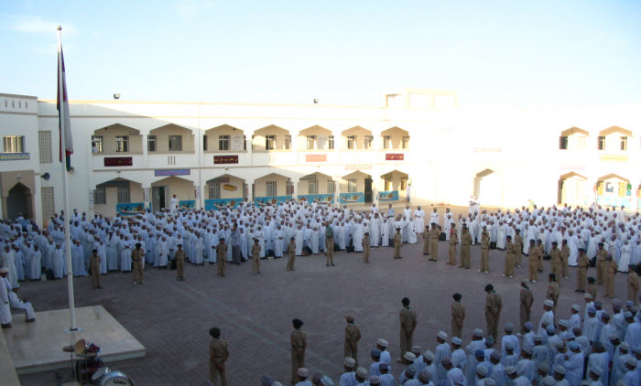
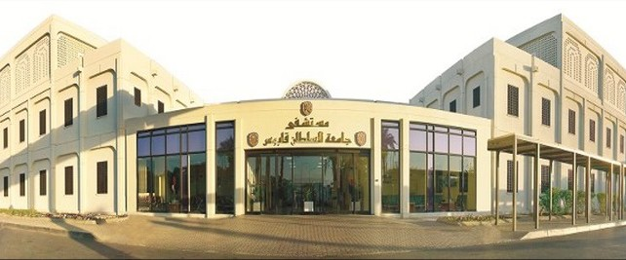
Over Head Line Strikes & excavation
January 2015 – October 2016
The cost of these 23 incidents
was enough to educate 60 students for a year
Was enough to build 1 hospital
A cost to the sultanate of Oman
Notes:
Between January 2015 and October 2016
That is just 22 months
PDO & its contractors have suffered 23 incidents involving overhead line strikes and excavation.
9 incidents in 2015 with 1 incident costing 50,000 OMR
14 incidents in 2016 with 2 incidents costing over 500,000 OMR 10 x more than the previous year.
This is enough money to put 60 students through a year in school here in Oman
This is enough to build an additional hospital here in Oman

Slide 12
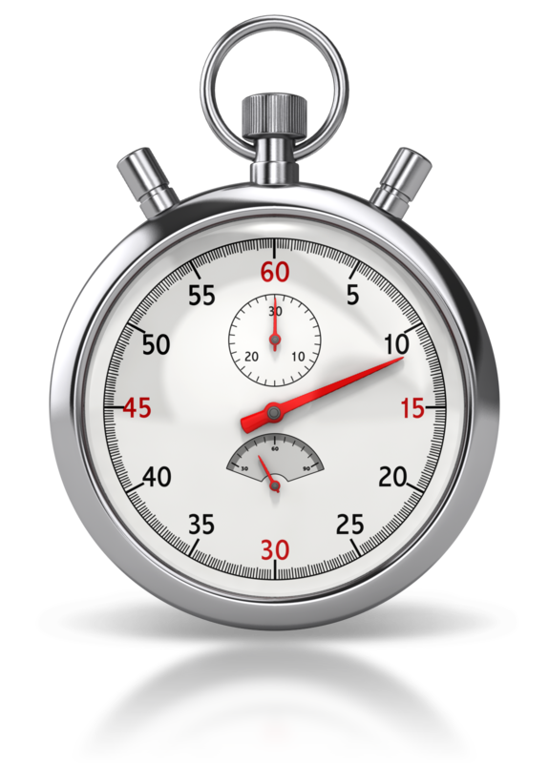
Time vs hse
Notes:
Two of the biggest excuses we hear REPEATED time and time again is:
We don’t have time
HSE is slowing the operation down
Move to next slide

Slide 13
Time vs hse
“All this safety stuff takes time doesn’t it?”
“I’m too busy!”
“I can’t possibly do all this!”
“The boss wants the job done NOW!”
“Your always talking about safety but nothing really changes!”
Sound familiar?!
Notes:
We all know that safety and productions clash, but they shouldn’t. They go together hand in hand.
If you do the job correctly and as per the training or procedure then you shouldn’t get hurt and when an incident does occur, if you ensure the learnings are shared and understood by the attendees then we should be able to prevent a reoccurrence………STOP the REPEAT incidents

Slide 14
Those who do not know the past are destined to:
الأخرون الذين لا يعرفون الحوادث الماضية سيتعرضون الى :
Repeat تكرار Repeat تكرار
Repeat تكرار Repeat تكرار
Repeat تكرار Repeat تكرار
Repeat تكرار Repeat تكرار
Repeat تكرار Repeat تكرار
Repeat same mistakes نفس الأخطاء

Slide 15
Learning from incidents
What did YOU learn today about REPEAT incidents?
What are YOU going to do differently to stop REPEAT incidents?
Repeat تكرار
Notes:
This is the closing interactions section.
Ask the first question and ensure engagement from the attendees. Ensure you check for understanding by randomly asking individuals (especially quiet or people who appear to be uninterested) to explain what you have told them about in today’s work stoppage
Then ask the second question
Get them All to commit to working safely.
Check understanding again.

