Slide 1
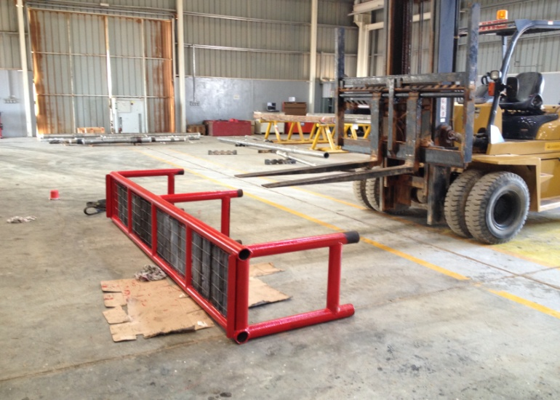
PDO Incident First Alert
Incident type | LTI (#40) | PIM ID | 1095565
Date/ time | 27.11.2016 at 08:00 hrs. | Directorate
Location | Workshop Yard Nimr | Dept
What happened
After painting an inspection tool rack a Technician assisted by a 3rd party Fork Truck Driver attempted to manually turn the tool rack weighing 280kg over to paint the other side, the tool rack was dropped trapping the Fork Truck Drivers left foot underneath resulting in a fracture.
Mr. Musleh asks the questions of can it happen to you?
Do you ensure you use the correct equipment for the task?
Do you assess the weight of an object before manual handling?
Do you consider if you are in the ‘line of fire’?
Foot crush point
Please disseminate this LTI notification to your teams and use it in your tool box talks and HSE meetings and notice boards.

