Slide 1
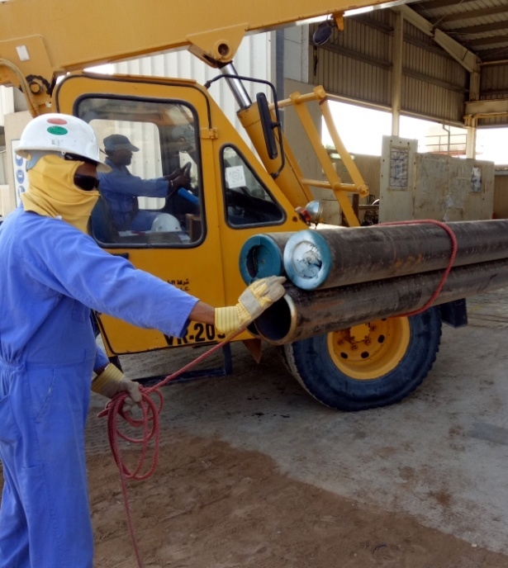
PDO Incident First Alert
Incident type | LTI (#41) | PIM ID | 1096013
Date/ time | 01.12.2016 at 10:00 hrs. | Directorate
Location | Workshop Yard Lekhwair | Dept
What happened
Two riggers were engaged in moving pipes from the yard to the workshop. Whilst offloading the pipes, one of the riggers placed his hand on the pipes trapping his right hand between 2 pipes fracturing his ring finger.
Mr. Musleh asks the questions of can it happen to you?
Do you ensure you keep your hands away of crush points?
Do you use the correct method to do the job?
Do you consider if you are in the ‘line of fire’?
Crush point
Please disseminate this LTI notification to your teams and use it in your tool box talks and HSE meetings and notice boards.

