Slide 1
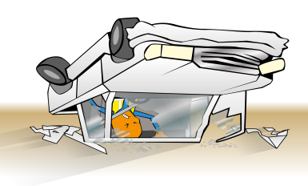
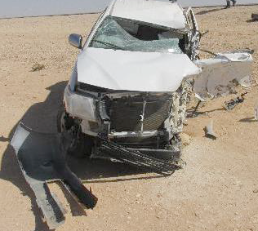


PDO Incident First Alert
Incident type | LTI#43 | PIM ID | 1096247
Date/ time | 18.12.2016 at 09:00 hrs. | Directorate
Location | Nimr-Rima road | Dept
What happened
Pick-up was traveling on the Nimr to Rima road. when it crossed the center line and collided with a truck on driver side. The accident resulted serious injures to the driver with the remaining passengers received minor injuries and the truck driver was unharmed .
Mr. Musleh asks the questions of can it happen to you?
Do you follow your defensive driving techniques?
As a passenger .Do you intervene when the driver drive unsafely ?
Do you continue driving if you are fatigued?
Please disseminate this LTI notification to your teams and use it in your tool box talks and HSE meetings and notice boards.

