Slide 1
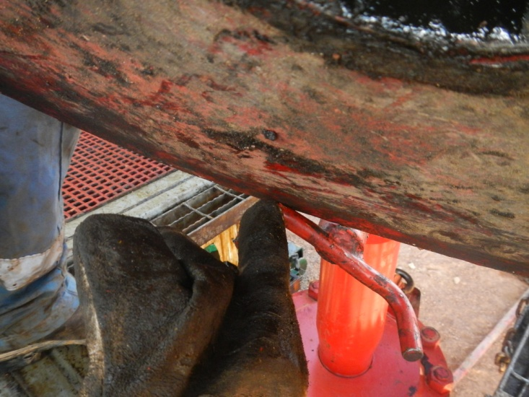
PDO Incident First Alert
Incident type | LTI (#01)
Date/ time | 03.01.2017 at 17:15 hrs. | Directorate
Location | Hoist 103, Nimr area | Dept
What happened
While installing the wiper rubber for the sucker rod blow out preventer (BOP), a floorman was manually lifting the BOP table with his colleagues when his left hand was trapped between the table and the BOP screws, resulting in a fracture to his left hand little finger.
Mr. Musleh asks the questions of can it happen to you?
Do you ensure you keep your fingers away from pinch points?
Can this be done with mechanical aids?
Do you ensure good communication and coordination with your colleagues?
Point where little finger was trapped
Please disseminate this LTI notification to your teams and use it in your tool box talks and HSE meetings and notice boards.

