Slide 1
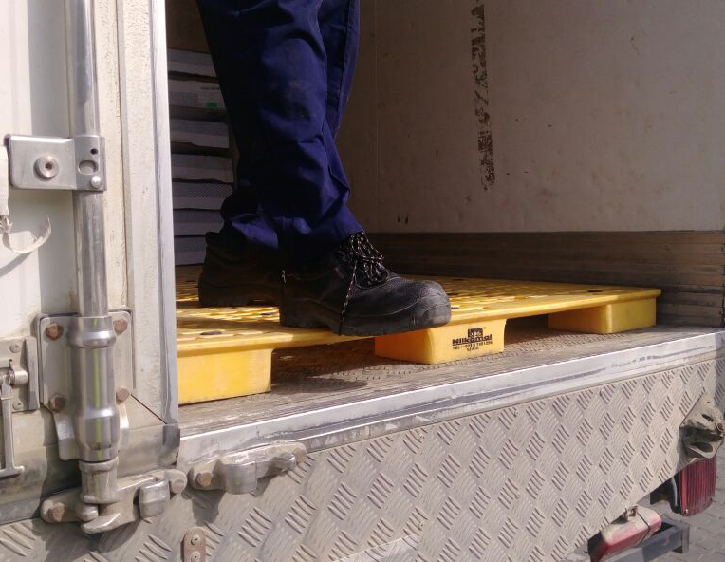
PDO Incident First Alert
Incident type | LTI (#02)
Date/ time | 13.01.2017 at 17:05 hrs. | Directorate
Location | Rig 43 – Wadi Musallam | Dept
What happened
While exiting the back of a food supply truck, a delivery helper tripped on the edge of a pallet falling to the ground landing on his left arm, resulting in a fracture to his left wrist.
Mr. Musleh asks the questions of can it happen to you?
Do you ensure you have safe access and egress?
Do you ensure you take your time when climbing out of your vehicle?
Do you ensure that deliveries are supervised?
Please disseminate this LTI notification to your teams and use it in your tool box talks and HSE meetings and notice boards.

