Slide 1
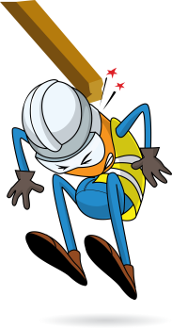
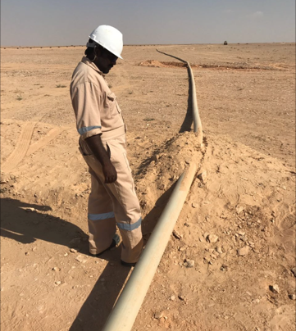
PDO Incident First Alert
Incident type | LTI (#03)
Date/ time | 17.01.2017 at 09:45 hrs. | Directorate
Location | Rima NHM Field | Dept
What happened
While moving the Reinforced Framework Piping, the pipeline was pulled by a mechanical shovel which resulted in the pipeline hitting a helper resulting in a fracture to his lower left leg.
Mr. Musleh asks the questions of can it happen to you?
Do you ensure you are stood in a safe place?
Do you stop operations when people enter restricted work areas?
Do you always consider if you are in the ‘line of fire’?
Pipe direction of movement when pulled by mechanical shovel
Please disseminate this LTI notification to your teams and use it in your tool box talks and HSE meetings and notice boards.

