Slide 1
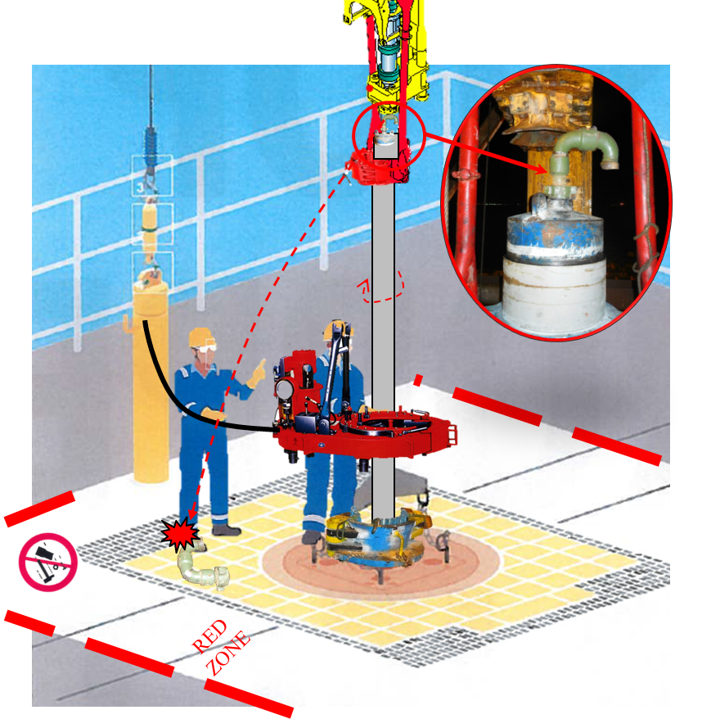
PDO Incident First Alert
Incident type | LTI (#04)
Date/ time | 18.01.2017 at 02:20 hrs. | Directorate
Location | Rig 19 - Rabab | Dept
What happened
While two operators were making up a casing joint, the chiksan swivel joint weighing 24kg came loose from the casing head and fell 13 metres landing on the operators foot resulting in a fracture to his right foot.
Mr. Musleh asks the questions of can it happen to you?
Do you ensure you have secondary retention in place?
Do you always ensure you are protected from dropped objects?
Do you always consider if you are in the ‘line of fire’?
Chiksan swivel joint
Please disseminate this LTI notification to your teams and use it in your tool box talks and HSE meetings and notice boards.

