Slide 1
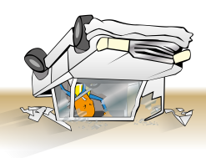
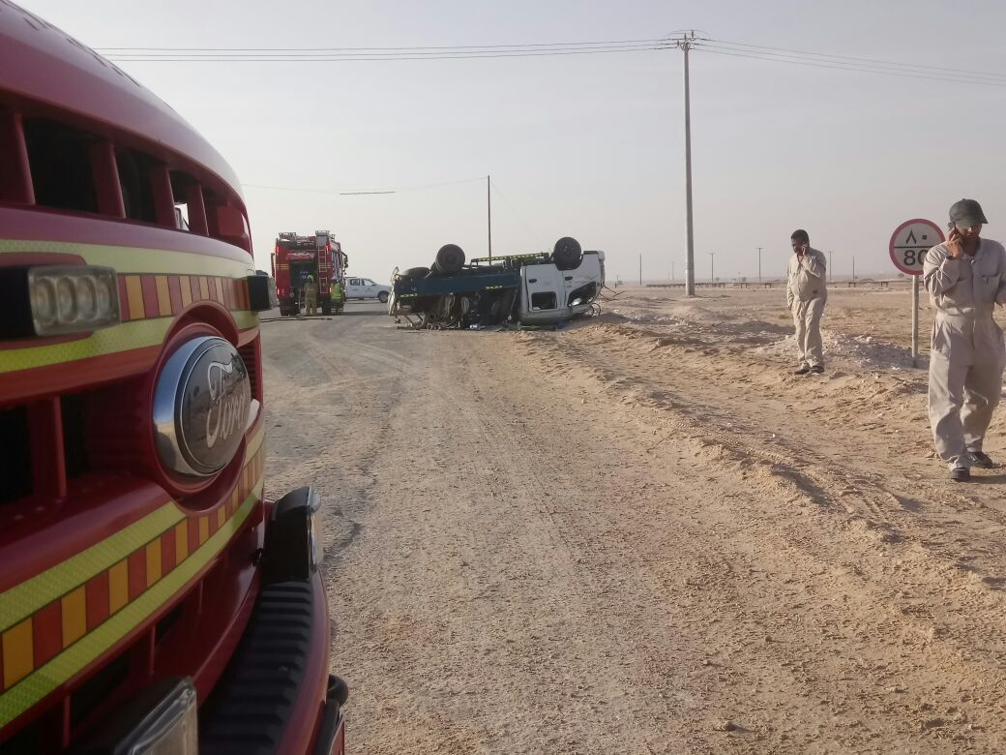
PDO Incident First Alert
Incident type | LTI (#05)
Date/ time | 18.01.2017 at 07:30 hrs. | Directorate
Location | Yibal | Dept
What happened
After negotiating a left turn near Yibal “C” station, a Canter driver lost control of the vehicle rolling over and landing on its roof. One passenger received an injury to his spine while the driver and 4 other passenger received minor injuries.
Mr. Musleh asks the questions of can it happen to you?
Do you always wear your seatbelt?
Do you follow your defensive driving techniques?
Do you drive at the appropriate speed for the road conditions?
Do you, as a passenger intervene when the driver drives unsafely?
Please disseminate this LTI notification to your teams and use it in your tool box talks and HSE meetings and notice boards.

