Slide 1
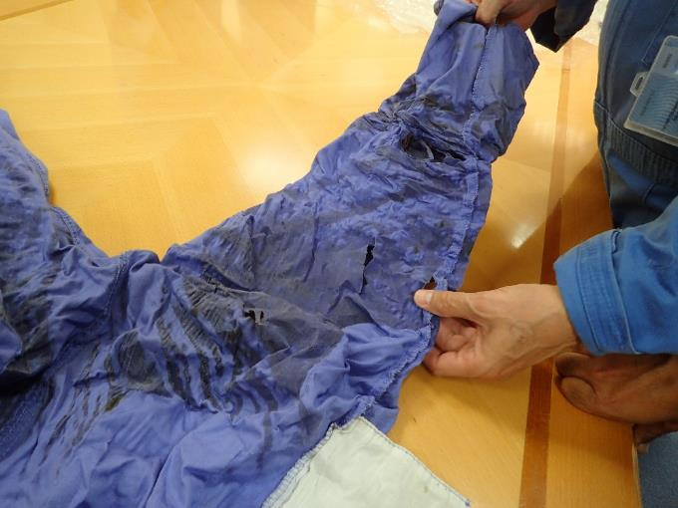
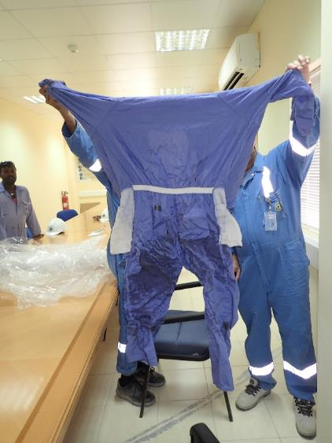
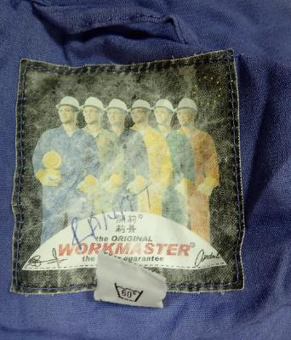
Safety Alert
Use this Alert: Discuss in Tool Box Talks and HSE Meetings ➔ Distribute to contractors ➔ Post on HSE Notice Boards ➔ Include in site HSE Induction
Inadequate PPE standards hazard
A pipe fitter, was wearing a 40/60% polyester coverall when he was caught up in an incident involving static electricity which resulted in a fire. Due to the heat his coverall melted and caught fire. As he was wearing long cotton undergarment he was able to quickly remove his coverall, and only sustained injuries on parts of his body that were not protected by his cotton undergarment.

Slide 2
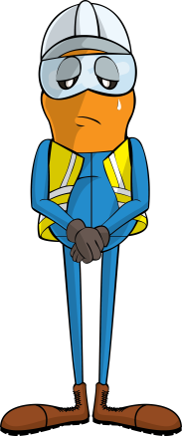
Safety Alert
Mr. Musleh asks the questions of can it happen to you?
Do you ensure your coveralls are 100% cotton with reflective strips (PPE Procedure SP-1234 compliant)?
Does your risk assessment state the correct specification?
Does your clothing fit correctly?
Do you know the hazards associated with the job you are doing?

