Slide 1
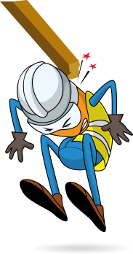
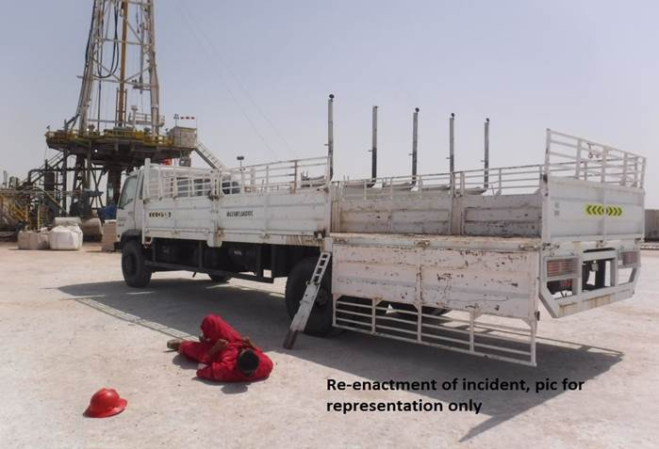


PDO Incident First Alert
Incident type | LTI (#07)
Date/ time | 11.03.2017 at 13:50 hrs. | Directorate
Location | Yibal | Dept
What happened
While the driver was opening the side panel of his trailer in order to offload , he fainted and fell to the ground . As he collapsed he was struck by the side panel of the trailer resulting in a fracture to his left leg
Mr. Musleh asks the questions of can it happen to you?
Do you ensure you report all medical conditions?
Do you ensure you are inducted and authorised to enter the site?
Do you ensure you are out of the line of fire?
Please disseminate this LTI notification to your teams and use it in your tool box talks and HSE meetings and notice boards.

