Slide 1
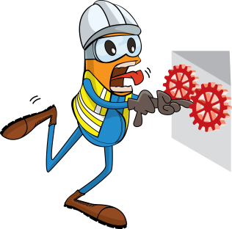
PDO Incident First Alert
Incident type | LTI (#08)
Date/ time | 23.03.2017 at 12:00 hrs. | Directorate
Location | Marmul | Dept
What happened
Whilst moving a load via winch truck between locations, the load has came off the trailer causing the front wheels to lift spinning the steering wheel, catching the drivers hand resulting in a fracture to his left hand ring finger.
Mr. Musleh asks the questions of can it happen to you?
Do you ensure you correctly secure all loads?
Do you ensure you follow the correct hand placement on the steering wheel while driving ?
Please disseminate this LTI notification to your teams and use it in your tool box talks and HSE meetings and notice boards.

