Slide 1
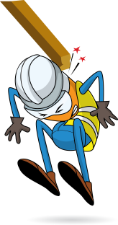
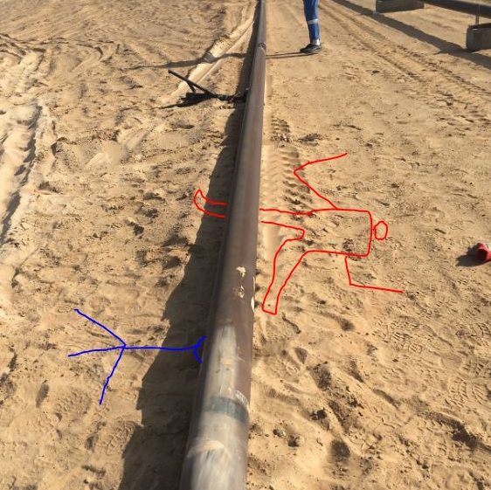


PDO Incident First Alert - Galfar
Incident type | LTI (#09)
Date/ time | 02.04.2017 at 11:20 hrs. | Directorate | Oil North
Location | Lekhwair | Dept | ONE
Pipe direction of movement when flexed
What happened
While fitting a flow line the mechanical team were placing 6” pipe on two tripods to support the pipe. At this point the mechanical foreman was walking past the pipeline at the same time as the pipeline flexed, falling from the supporting tripods landing on his right leg resulting in a fracture to his right leg.
Mr. Musleh asks the questions of can it happen to you?
Do you ensure you are stood in a safe place?
Do you consider the release of stored energy?
Do you always consider if you are in the ‘line of fire’?
Please disseminate this LTI notification to your teams and use it in your tool box talks and HSE meetings and notice boards.

