Slide 1
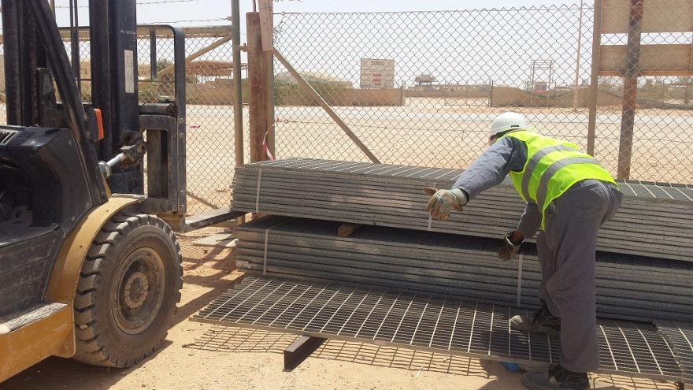
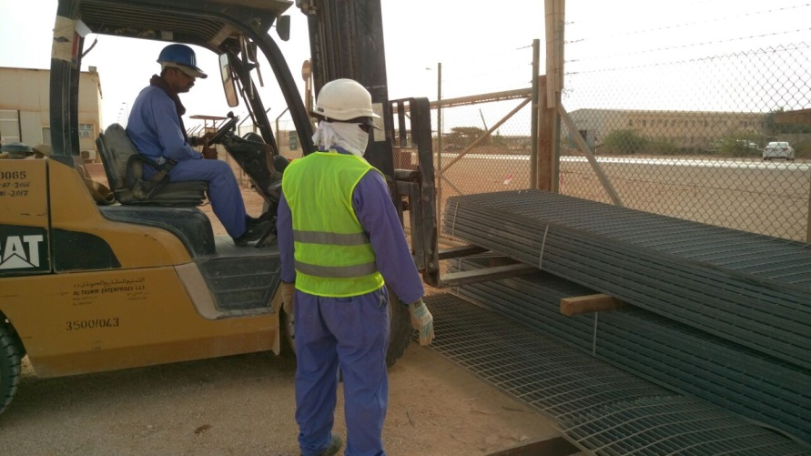
PDO Second Alert
Date: 14.09.2016 Incident title: Nimr
What happened?
The banksman was guiding a forklift, stacking bundles of gratings. As the operator lowered the bundle, the banksman placed his hand between the bundles to align a piece of dunnage in between. His right hand thumb was caught between the top of the dunnage and the metal grating bundle, crushing his thumb.
Your learning from this incident..
Plan the job and ensure availability of competent person
Arrange required resources for the job in hand.
Follow PDO lifting procedures
Green hands shall be used under close supervision
Never place yourself in line of fire

Slide 2
Management self audit
Date: 14.09.2016 Incident title: Nimr
As a learning from this incident and to ensure continual improvement all contract managers must review their HSE HEMP against the questions asked below
Confirm the following:
Are all Lifting activities identified in the HEMP?
Do you ensure that competent personnel are assigned for the job?
Have you ensured supervision for the job?
Do your staff ensure that they are authorized to carry out the task?
Have you created awareness on safe behavior to avoid crush points?
Have you trained your employees about safe work practices when they are in the ‘line of fire’?
Do your lifting procedures comply with PDO’s?
Notes:
Make a list of closed questions (only ‘yes’ or ‘no’ as an answer) to ask other contractors if they have the same issues based on the management or HSE-MS failings or shortfalls identified in the investigation. Pretend you have to audit other companies to see if they could have the same issues.

