Slide 1
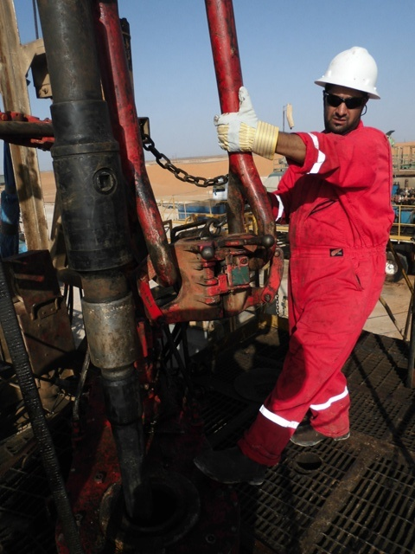
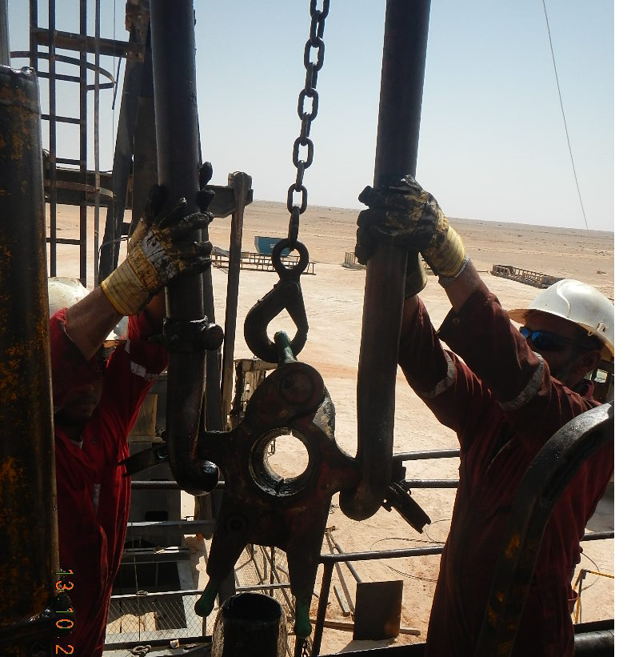
PDO Second Alert
Date: 22.09.16 Incident title: LTI foot injury
What happened?
Whilst disconnecting the elevator from the elevator bail to lower it to the work floor using the Cat line, the driller hooked the Cat line onto the elevator and together with a floorman began to remove the retaining bolts from the link lock. As the floorman pulled the elevator bail towards him from the side (to unlatch the elevator from elevator bail), the elevator dropped due to a lack of tension on the Cat line landing on the floorman left foot.
Your learning from this incident..
Ensure communication between the workers who are jointly participating in performing the task
Ensure adequate supervision while performing routine tasks and stop the activity if you feel it is unsafe.
Ensure all steps of an activity are covered in the TBT and ensure all personnel understand them and have identified the hazards involved.
Cat lines
Ensure cat line are under tension before removing elevator bolts

Slide 2
Management self audit
Date: 22.09.16 Incident title: LTI foot injury
As a learning from this incident and to ensure continual improvement all contract managers must review their HSE HEMP against the questions asked below
Confirm the following:
Do your employees know who is person in charge of hoisting operation?
Do your employees understand the term “Line of Fire” and the potential risks ?
Do you adequately conduct HSE audits to prevent shortcuts /shortfalls?
Notes:
Make a list of closed questions (only ‘yes’ or ‘no’ as an answer) to ask other contractors if they have the same issues based on the management or HSE-MS failings or shortfalls identified in the investigation. Pretend you have to audit other companies to see if they could have the same issues.

