Slide 1
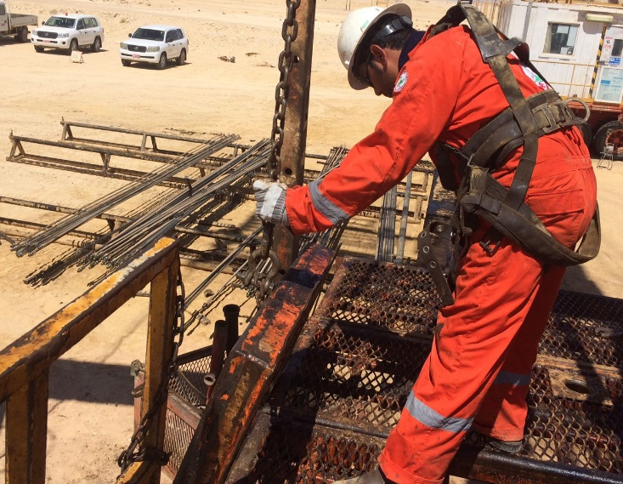
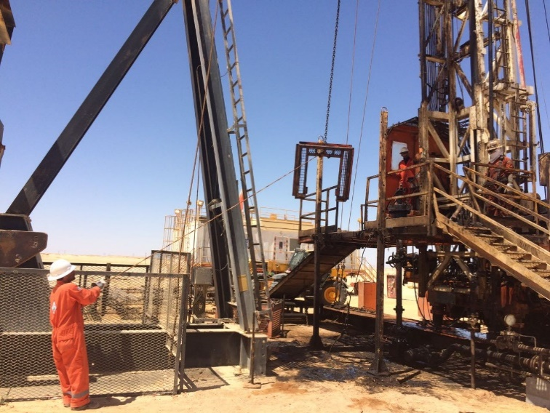
PDO Second Alert
Date: 29.09.2016 Incident: LTI
What happened?
While preparing the rig floor for RIH SR String, the Roustabout was installing the hand rail. The Driller noticed, that the rig floor slips (part of the Safety Floor) cover was not set. He instructed the Roustabout to install the Safety Floor Cover. The Safety Floor Cover was hanging on the winch line beside the v-door. The Driller started to raise the Safety Floor Cover by operating the winch line. The Safety Floor Cover got stuck on the rig floor. The Roustabout stepped in and tried to release it by pushing the winch line. As it was under tension it released and hit the Roustabout near his lips.
Your learning from this incident..
Ensure proper planning of Lifting Operations
Use the correct Lifting Method (tag line)
Stay out of the Line of Fire
Never block the view of the operator with your body
Immediately STOP if you cannot see the load or the banksmen
Use the correct Lifting method – Use a tagline

Slide 2
Management self audit
Date: 29.09.2016 Incident: LTI
As a learning from this incident and ensure continual improvement all contract
managers must review their HSE HEMP against the questions asked below
Confirm the following:
Do you have designated and specially designed Tag lines available on each worksite?
Have you trained your staff on hoisting operations with winch lines and the usage of tag lines?
Do you have standard lifting plans in place for winch line operations?
Do you have a SOP for winch line operations?
Does your HEMP / JSA / Risk Register contain the hazards associated with winch line operations?
Notes:
Make a list of closed questions (only ‘yes’ or ‘no’ as an answer) to ask other contractors if they have the same issues based on the management or HSE-MS failings or shortfalls identified in the investigation. Pretend you have to audit other companies to see if they could have the same issues.

