Slide 1
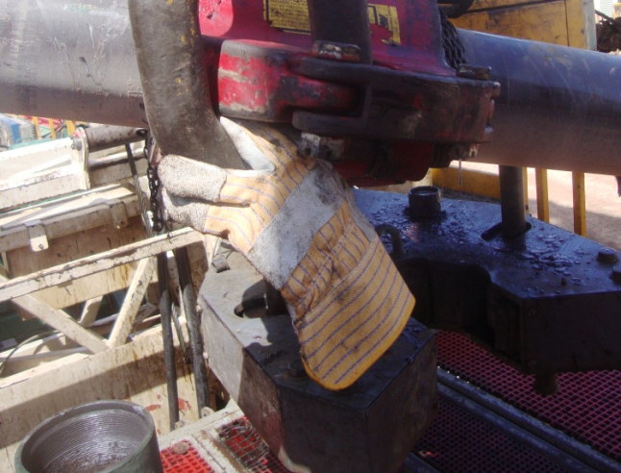
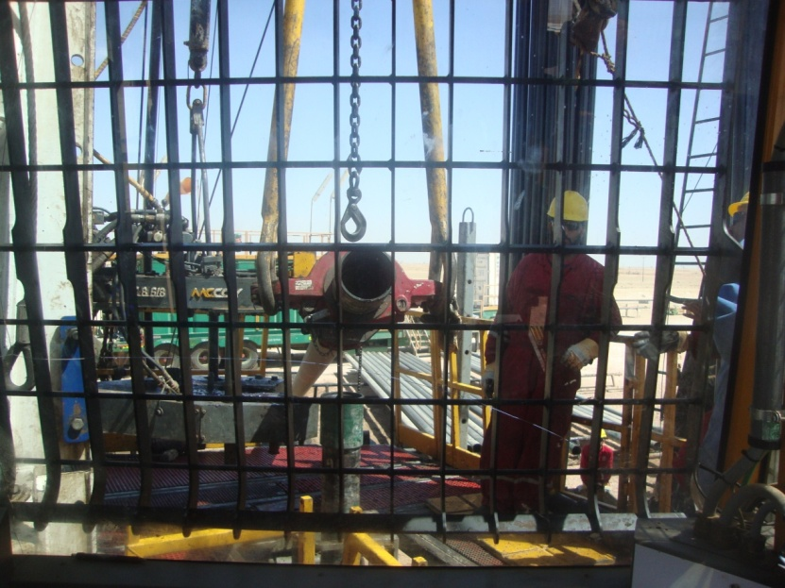
PDO Second Alert
Date:23.09.16 Incident: Finger Injury
What happened?
While running in the hole with 7” casing, joint #6 was picked up and moved to the floor using a sling. The Floorman hooked up the casing elevator and installed the safety pin. Thereafter the Floorman signaled to the driller to lower the winch line. While waiting the Floorman put his left hand between the elevator and bail eye. As the winch was lowered his Left Hand index finger was crushed resulting in damage to his finger and nail bed.
Your learning from this incident..
Ensure risk assessment is done, communicated to work force and followed at all times
Ensure pinch points & safe handling points are clearly identified / painted
Ensure communication of pinch points specific to the job
TBT must cover job-specific hazards.
Always keep your hands and fingers away from the Line of Fire

Slide 2
Management self audit
Date:23.09.16 Incident: Finger Injury
As a learning from this incident and ensure continual improvement all contract
managers must review their HSE HEMP against the questions asked below
Confirm the following:
Do you have a pinch point register to identify the spots that needs to be visualized as hazardous and safe-to-handle areas on the equipment?
Do you ensure impact gloves are used by critical positions?
Do you have hands and finger injury prevention program?
Do you have systems in place to rollout Procedures and Guidelines in your organization?
Notes:
Make a list of closed questions (only ‘yes’ or ‘no’ as an answer) to ask other contractors if they have the same issues based on the management or HSE-MS failings or shortfalls identified in the investigation. Pretend you have to audit other companies to see if they could have the same issues.

