Slide 1
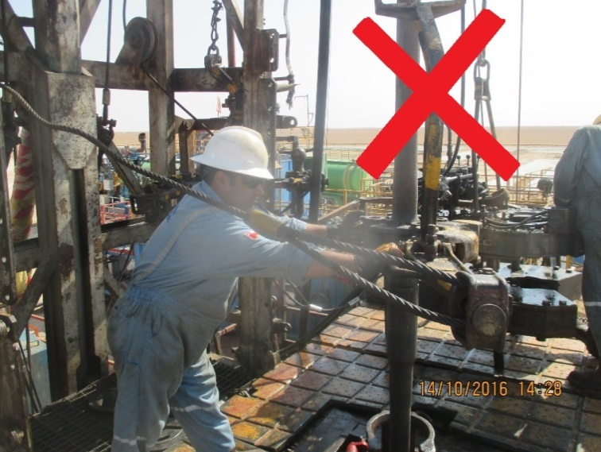
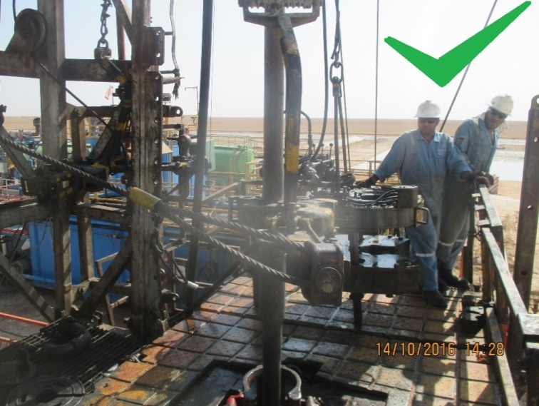
PDO Second Alert
Date: 27.09.16 Incident title: LTI
What happened?
When breaking out the first connection following Milling operations, a Manual Tong was latched onto the Drill Pipe to secure it in place. The bottom connection had already been broken and was resting in the thread housing from the below Drill Pipe.
The Manual Tong was slipping on the Drill Pipe when force was applied through the Power Swivel so the Driller instructed the Floor Man to stay within the Red Zone to hold it in place.
Your learning from this incident..
Always ensure you talk about the importance of the Red Zone during your Tool Box Talks
Do not remain within the Red Zone while equipment is being operated
Always check that your equipment is correctly placed, prepared or secured before applying torque and increasing the potential energy.
Always check the Rig Floor is clear before operating equipment
Make sure all crew members understand the empowerment to stop an unsafe act.
When operating the Tongs under tension,
make sure all crew keep clear

Slide 2
Management self audit
Date: 27.09.1 Incident title: LTI
As a learning from this incident and to ensure continual improvement all contract managers must review their HSE HEMP against the questions asked below
Confirm the following:
Are all crew members aware of the potential risks of the equipment used?
Are all crews aware of the importance of the Red Zone?
Is all equipment and materials checked before they are used?
Are all PSP’s regularly monitored and up to date?
Notes:
Make a list of closed questions (only ‘yes’ or ‘no’ as an answer) to ask other contractors if they have the same issues based on the management or HSE-MS failings or shortfalls identified in the investigation. Pretend you have to audit other companies to see if they could have the same issues.

