Slide 1
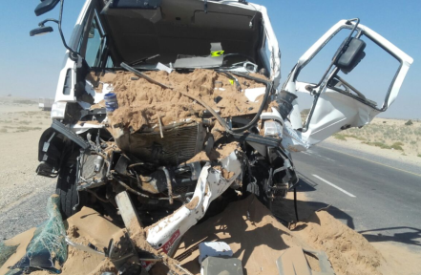
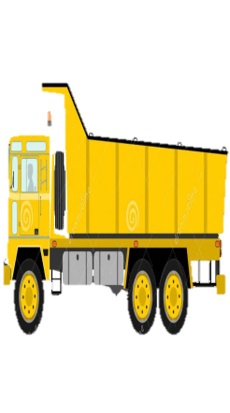

PDO Second Alert
Date: 15.11.2016 Incident title: MVI LTI
What happened?
On 15.11.2016, contractor working for KDC2 project was using a water tanker to deliver 7.5K gallons of drinking water from Fahud to KDC2 project camp site. At around 09.48 am, near Natih round-about towards Nizwa, a third party tipper travelling in front of the water tanker reduced its speed to avoid camels that were crossing the road. The water tanker driver failed to keep enough distance and / or sufficiently reduce his speed and hit the back of the tipper.
Your learning from this incident..
Follow Defensive driving techniques
Maintain a safe distance between the vehicle in front
Reduce speed when wild animals are present
Be alert to hazard warning road signs
Be alert to the action of other road users.
Photo explaining how it should be done right
Safe Distance
4 Second Minimum
Keep a safe distance between the vehicle in front

Slide 2
Management self audit
Date:15.11.2016 Incident title: MVI LTI
As a learning from this incident and to ensure continual improvement all contract managers must review their HSE HEMP against the questions asked below
Confirm the following:
Have all drivers attended proper site HSE & Road Safety induction?
Are all drivers routinely reminded of defensive driving techniques in Driver’s Forums, TBT, etc?
Have route hazard surveys been completed by the Journey Manager as per SP 2000 requirements?
Have all drivers gone through PDO Fitness to Work medicals as per SP-1230?
Do all drivers comply with mandatory trainings as per SP-1157?
Is IVMS data monitored and counseling / consequence management applied for any driving related violations?
Notes:
Make a list of closed questions (only ‘yes’ or ‘no’ as an answer) to ask other contractors if they have the same issues based on the management or HSE-MS failings or shortfalls identified in the investigation. Pretend you have to audit other companies to see if they could have the same issues.

