Slide 1
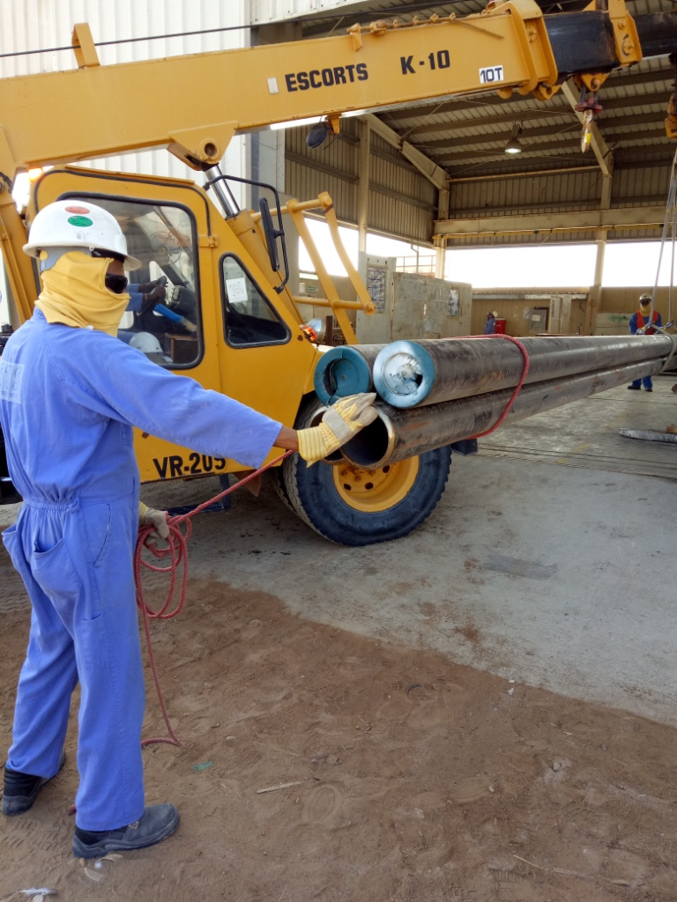
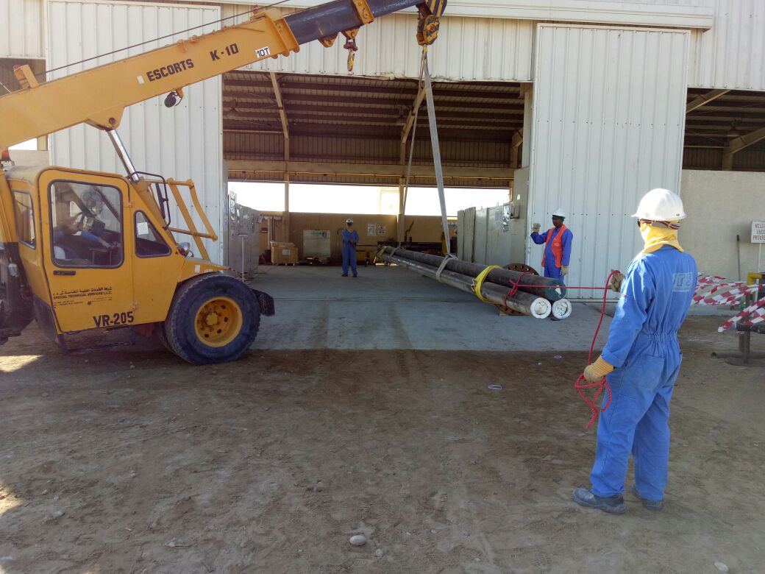
PDO Second Alert
Date : 01.12.2016 Incident type: LTI
What happened?
A contractor mechanical crew consisting of two riggers and a “pick & carry- Hydra” crane operator was engaged in shifting of four numbers of 6 inch dia X 12 metre length CS pipe from l yard to fabrication shop.
Whilst offloading the pipes in the fabrication shop, one of the riggers pushed the load by right hand and his right ring finger got trapped between the pipes resulting in a crush injury to the tip of the finger.
Your learning from this incident.
Ensure your hand & fingers are out of “line of fire”.
Be aware of crush points & pinch points.
Comply with lifting & rigging procedures and specifications.
Always ensure pipes of dia more than 5.5 inch are bundled and lifted in odd numbers
Even number of pipes
Always keep your hands away from crush points (Line of Fire)
1

Slide 2
Management self audit
Date: 01.12.2016 Incident type: LTI
As a learning from this incident and to ensure continual improvement all contract managers must review their HSE HEMP against the questions asked below
Confirm the following:
Do you have a pinch point program taking place in your company?
Do you have effective hand & finger campaigns?
Do you address the element of ‘Behavior’ for hand and finger injuries prevention?
Do you follow the 10 questions for a safe lift ?
Do you ensure adequate supervision?
Notes:
Make a list of closed questions (only ‘yes’ or ‘no’ as an answer) to ask other contractors if they have the same issues based on the management or HSE-MS failings or shortfalls identified in the investigation. Pretend you have to audit other companies to see if they could have the same issues.

