Slide 1
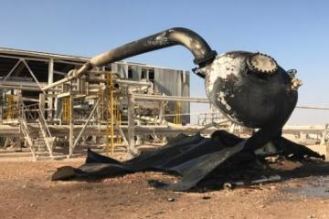
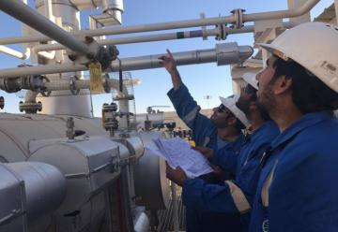
PDO safety advice
Date: 08.12.2016 Incident type: AIPS & LTI
What happened?
Bahja Gathering station was recently by passed and the Operations team were preparing for the facility to be Decommissioned. When the team proceeded with depressurizing the Gas section the Flare KOD vessel ruptured and exploded injuring the operator.
It was a closed valve in the flare line after this low pressure vessel resulted in pressure build up, followed by rupture, explosion and fire.
Your learning from this incident…
Align LO/LC register with PEFS and ensure compliance with 3-month and 6-month checks & audit.
Preparatory activities for Decommissioning to be
Planned
Method statement prepared
Risk assessment done
Actual site conditions verified with drawings
Walk the line
Necessary resources and interfaces be identified and confirmed
Photo explaining how it should be done right
Always “Walk the line”
Make sure your PEFS are Up-to-Date

Slide 2
Management actions
Date: 08.12.2016 Incident type: AIPS & LTI
As a learning from this incident and to ensure continual improvement all contract managers must review their HSE HEMP against the questions asked below
Confirm the following:
Do management carry out their assurance checks even when the asset is out of use?
Are all Safety critical valves clearly identified and in the maintenance plan
Do all operators return systems to as before after any task

