Slide 1
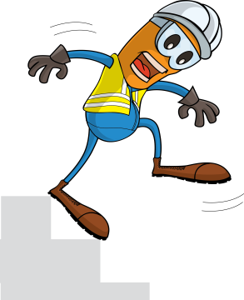
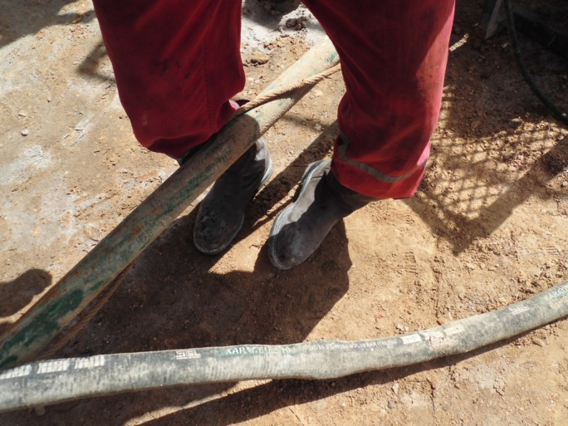
PDO Incident First Alert
Incident type | LTI (#11)
Date/ time | 24.04.2017 at 16:20 hrs. | Directorate
Location | Yibal | Dept
What happened
After connecting the cellar pump suction hose to remove water from the cellar, the Derrickman crossed the kill line where he tripped losing his balance and twisting his left ankle. The X ray revealed a fractured bone in his left foot.
Mr. Musleh asks the questions of can it happen to you?
Do you ensure you have safe access and egress?
Do you always pay attention to where you are stepping?
Do you ensure housekeeping is done regularly?
Please disseminate this LTI notification to your teams and use it in your tool box talks and HSE meetings and notice boards.

