Slide 1
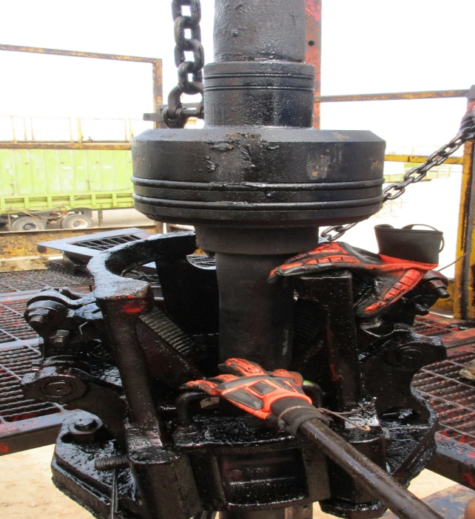
PDO Incident First Alert
Incident type | LTI (#12)
Date/ time | 29.04.2017 at 12:00 hrs. | Directorate
Location | Rima small fields | Dept
What happened
During running in the hole 11" tubing hanger, a Floorman was removing the slip's door, when the traveling block moved, crushing the Floorman's right hand between the top of the slips and the tubing hanger.
Mr. Musleh asks the questions of can it happen to you?
Do you always use the handles provided?
Do you ensure you keep your hands away of crush points?
Do you ensure you are away from “Line of Fire”?
Please disseminate this LTI notification to your teams and use it in your tool box talks and HSE meetings and notice boards.

